Slide 1

AASECT 48th Annual Conference June 8 - 12, 2016 • San Juan, Puerto Rico
Speaker Disclosure:
I have no financial relationships
or affiliations to disclose.

Slide 2

BDSM and Intimate Partner Violence
Developed by Susan Wright & Ashley Haymond, 2016
Notes:
Developed by myself and Ashley Haymond, a Widener University student, last summer. NCSF does a lot of work with victim advocates and we assisted in creating the NYC AVP anti-violence module, so we realized we could give this information directly to therapists, educators and victim advocates. This is usually a 3 hour class, so we’re crunching it down. We’ve given 35 of these workshops so far this year and we have another Widener University student who’s interested in making this their internship, in the fall.

Slide 3
Today’s Plan
Why should you become kink aware?
What is BDSM?
BDSM terms you may encounter
Consent vs. Abuse: How to tell the difference
Potential questions to ask clients
Case Studies
Concluding discussion
Notes:
APPROXIMATE TIMING OF THESE ACTIVITIES:
1. Introductions, goal setting & planning [10 minutes]
Who we are
Who you are
Today’s goals & purpose
Plan for today

Slide 4
BDSM A composite acronym
Bondage and Discipline,
Dominance and Submission,
Sadism and Masochism
Notes:
Kink is rapidly becoming the favored word. It is a wider umbrella that includes BDSM, fetishes, cross-dressing

Slide 5
Why Should You Become Kink Aware?
Over 4,400 people
29% (1,300 people) said their pre-negotiated limits had been violated in a BDSM scene or relationship
11% (140 respondents) accessed Victim Services or counseling
(NCSF Consent Violations Survey, 2014)
Notes:
Of those who did seek help, 90% were happy with how they were treated. But very few kinky people know this service exists because they expect that like the police, which they largely distrust, victim services will blame them for getting hurt.

Slide 6
Those at risk:
26% were violated before joining the BDSM community - they were isolated
80% of the victims identified as female, gender queer or transgender - the other 20% were male
84% identified as bottoms - 16% said they were tops
(NCSF Consent Violations Survey, 2014)
Notes:
From the Consent Violations Survey, 2014

Slide 7
Working with Law Enforcement: Two Sides of the Coin
Many police departments and prosecutors treat BDSM-related incidents with as much respect as any other.

Slide 8
The Victim Side
Problems when BDSM is involved:
Police officers won’t file a report
Detectives don’t investigate because they think some injury is to be expected in kink
Prosecutors won’t file charges because they think juries won’t understand how you can consent to a spanking but not intercourse

Slide 9
The Perpetrator Side
The bottom withdraws consent but the top doesn’t stop​
Injury occurs and the submissive partner goes to the hospital
Family/friends/coworkers report an observed injury to the police​
Medical personnel see an injury that they perceive resulted from abuse/assault.​
Pictures, videos, emails, film, or sound recordings of BDSM conduct somehow come into the hands of the police.

Slide 10
Appellate courts have not allowed consent as a defense ​
​
Treated as criminal assault rather than sexual assault

Slide 11
Benefits for Victims
Rape shield laws applicable
Victims could remain anonymous
Prior behavior not admissible
As is, victim could be outed
More likely to seek medical care or go to police

Slide 12
BDSM How many people are kinky?
2% in an Australian sample of nearly 20,000 adults admitted engaging in BDSM-related activities
May be aware of their BDSM interests as early as age 15
Richters et al (2008)

Slide 13
BDSM More research about kinky people
Score no differently than non-kinky people on mental health measures
When compared to a non-kinky control group
less neurotic
more extroverted
more open to new experiences
more conscientious
less sensitive to rejection
higher subjective well-being
Connolly et al (2006)
Wismeijer et al (2013)
Cramer et al (2015)

Slide 14
BDSM How many people are kinky?
1,040 Adults in Quebec
46% wanted to experience at least one paraphilic behavior
34% had done so at least once in the past
Wish to experience:
Voyeurism 46%
Fetishism 44%
Exhibitionism (couple) 31%
Frotteurism 27%
Masochism 24%
Sadism 7%
Joyal et al (2016)

Slide 15
Interest in sadomasochism not associated with childhood traumas (frotteurism was)
Desire to practice masochism associated with more diverse sexual interests than other paraphilias
Joyal et al (2016)

Slide 16
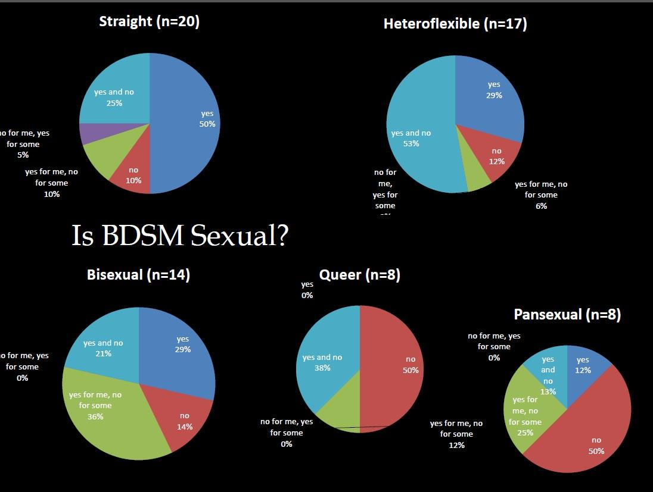
BDSM It’s all sexual, right? Not quite.
Answers varied by sexual orientation.
Fennell, J. (2015). Does this look sexual to you? Why do people do BDSM? Presentation to the DC Sociological Society. Washington, D.C.
Notes:
TKE: Is there going to be something that identifies the difference between heteroflexible, bisexual, pansexual? Also, I do not see homosexual listed here. Do you use another term or was it not in Fennell’s study? SW - it’s not in Fennell’s study, which uses Queer instead. But this should be noted in the notes.
NCSF surveys have traditionally found strikingly high percentage of bisexuals among the population who attend kinky educational groups and events - typically 30-40% of the survey respondents. This indicates to us that many people who are involved in the BDSM community choose partners based on the kinky role someone chooses is more important than their gender. It’s important not to be too focused on sexual orientation because even people who identify as heterosexual can play with people of the same gender, and people who identify as gay can play with people of the opposite gender.

Slide 17
Common themes for those who say BDSM is not sexual:
The Rush – endorphins, thrill of challenge, risk
Social Bonding – share experiences, intimacy
Spiritual – catharsis, transcending an ordeal
Fennell, J. (2015). Does this look sexual to you? Why do people do BDSM? Presentation to the DC Sociological Society. Washington, D.C.

Slide 18
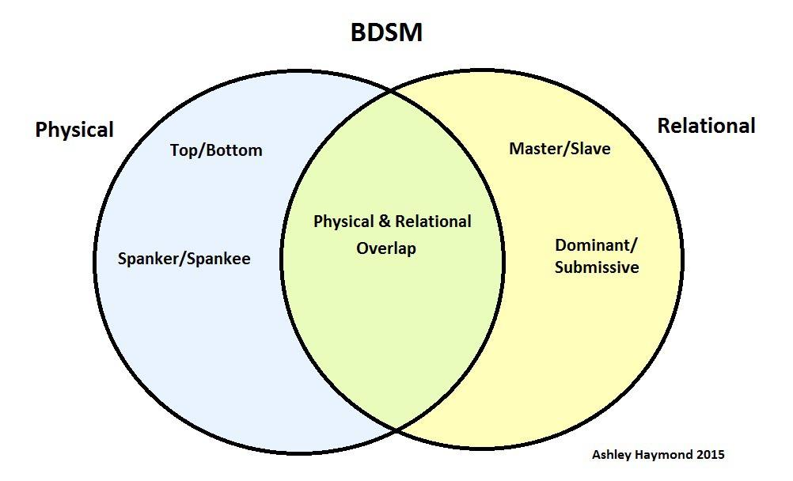
BDSM Physical and Psychological

Slide 19
BDSM Relational Aspects
Long-term relationships
Casual dating relationships
Acquaintances/Friends
Strangers (pick-up play)
Violence can occur in ANY of these variations
NCSF Consent Violations Survey (2014)
Notes:
This information comes from the Consent Violations Survey, 2014

Slide 20
BDSM A wide range of locations
In the home
Private Parties
Semi-public play spaces (Dungeons)
Hotels
Violence can occur in ANY of these locations
NCSF Consent Violations Survey (2014)
Notes:
This information comes from the Consent Violations Survey, 2014.

Slide 21
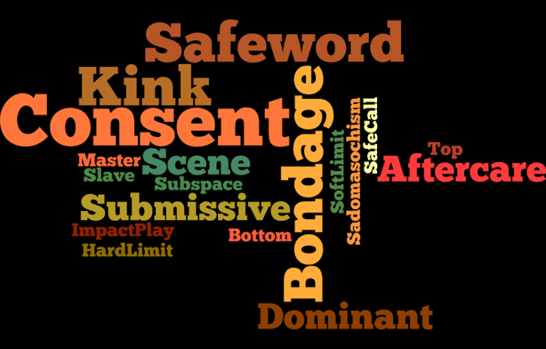

Slide 22
BDSM Terms
The term “scene” refers to a session of BDSM activities, typically defined within a period of time.
The “Scene” can also refer to the kink
subculture.
“The Lifestyle” is also used when kink is a
defining aspect of their relationship(s).
Notes:
We have our own cultural references - can also bring up “vanilla” as the term we use for those who aren’t kinky.

Slide 23
BDSM A wide range of behaviors
Roleplay
Bondage
Sensation play
Impact play
Fetishes
Edge Play
Power exchange

Slide 24
BDSM Relationships
Master/slave, 24/7, Mommy/boi
A power exchange relationship can be formal with a specific agreement called a “contract” in which one person consents to obey the other person and engage in certain BDSM activities.
The participants determine how this consent can be withdrawn if necessary.
NCSF Consent Statement (2012)
Notes:
This information comes from the NCSF Consent Statement

Slide 25
BDSM Relationship goals
A power exchange relationship should nurture the physical and emotional needs of everyone involved.
Harm causes lasting damage (whether physical, mental or spiritual) that impairs the ability to function and enjoy life
Hurt that is inflicted should ultimately bring fulfillment to those involved.
Notes:
TKE: I really like this definition. It is exactly what we use to explain the difference.

Slide 26
Safeword:
An agreed upon word that they can use to stop an activity at any time.
Safeword
Red, Yellow, Green
Safe signal - required when using a gag.
Notes:
TKE: This is an important distinction between not being “allowed” a safeword and people who say they don’t use them. I know many people who have them but have never used them because they communicate well with their partners.)
Anyone who says they weren’t allowed a safeword, is likely in an abusive relationship. Many people don’t use safewords - they simply communicate normally. The key is: can they stop the scene if they want to? Everyone must have a way to stop what is happening at any time.

Slide 27
Aftercare:
Emotional and physical care after a scene. Usually in reference to a top taking care of a bottom but sometimes the reverse.
Aftercare often includes touching base with a play partner the next day.
Notes:
TKE: I don’t think it is possible to emphasize the communication aspect enough! This is great.
Aftercare is part of the ongoing communication that is required to do kink. Communication starts with negotiation in the beginning, in which the limits are set for the scene, and continues throughout the interaction, and continues afterwards in the aftercare.

Slide 28
Sub-space:
Subspace is a trance-like state induced by the
body’s endorphins. They are released in response to pain, pleasure, or other intense sensations.
Notes:
Some people liken subspace to drinking or taking drugs because of the lack of inhibition and logical thought.

Slide 29
Consent vs. Abuse
Safe, Sane and Consensual (SSC)
Risk Aware Consensual Kink (RACK)
Notes:
Consent is in both community creeds:
Safe is being knowledgeable about the techniques and safety concerns involved in what you are doing, and acting in accordance with that knowledge.
Sane is knowing the difference between fantasy and reality, and acting in accordance with that knowledge.
Consensual is respecting the limits imposed by each participant at all times and being able to stop what’s happening at any time.
(from Leather Leadership Conference 1998)
Risk-aware: Both or all partners are well-informed of the risks involved in the proposed activity.
Consensual: In light of those risks, both or all partners have, of sound mind, offered preliminary consent to engage in said activity.
Kink: Said activity can be classified as alternative sex.
(from Wikipedia)

Slide 30
Limits
Hard Limits: Boundaries set on behaviors, words and interactions that are non-negotiable.
Soft Limit: A limit which can be more flexible than a hard limit and may be acceptable given a relationship or context in a scene.
Notes:
Each individual must set their own limits. A key sign of abuse is when one partner tells the other partners they are “no-limits”.

Slide 31
Informed consent is knowing:
Who will be involved
What you will be doing
Where it’s okay to touch and not touch
When there’s a health issue or risk of injury
Why you are doing this together
How you can stop what’s happening
Notes:
These are the points that need to be negotiated BEFORE doing a scene.

Slide 32
KINK
ABUSE
You have a way to stop what’s happening.
You discuss things as
equals prior to playing together.
You have enough information to know what you’re agreeing to do.
You can’t stop what’s happening.
There is little to no discussion about what will happen.
Your questions aren’t answered truthfully.
Notes:
Distribute Kink vs. Abuse Handout. Compare and contrast the statements on either side. The first thing everyone has to establish is that both can stop at any time and how that’s accomplished.

Slide 33
KINK
ABUSE
You set your own limits, and your partner(s) set theirs.
Your limits are respected by your partner(s).
You can express your feelings without fear.
You are tricked, coerced or pressured into doing things.
You may be forced to drink, take drugs or necessary medication is refused.
You are afraid to be honest about what you think and feel.
Notes:
Serial predators who prey on community members often force their victims to take drugs. They know there is far less chance of the victim reporting an assault if they took drugs because assault laws don’t offer anonymity to victims like sexual assault laws.

Slide 34
KINK
ABUSE
You can speak to whomever you choose.
Interactions happen when, how, and where you agree they happen.
You understand the risks involved.
You can’t speak to certain people or go certain places.
You are threatened and can’t leave.
You are seriously injured.
Notes:
These are more typical abuse scenarios - restricting who someone talks to and springing things on someone by surprise are hallmarks of abuse. Finally, even if it’s consensual, it’s criminal assault if someone seriously physically injures another person.

Slide 35

Questions to ask a client?
Did you consent to what happened?
Could you say no or safeword?
Were you able to set limits?
Were your pre-negotiated limits violated?
What happened when you wanted it to stop?
Notes:
10-15 Minutes for general discussion of the material thus far to come up with other questions you can ask.

Slide 36
Case Study 1: Mary
Mary is in her mid-thirties. She has a 3-year-old son with George, her husband of four years and father of her child. After talking to friends, she wants to know if she’s being abused, and if it’s OK to raise a child with him. This is her first inquiry to your service.
Notes:
See handout Rolplay 1: Mary for the detailed questions and answers.

Slide 37
Case Study 2: Mikey
Mikey is in his mid-thirties. He is a transman (female to male transgender person) who is single and lives alone. Several weeks ago, he had a bad first scene with a woman he recently met at a BDSM community event. This is his first inquiry to your service.

Slide 38
Case Study 3: Faye
Faye is in her late twenties. She is divorced with primary custody of her 3-year-old daughter. She has been in a relationship with a man for almost a year, but they don’t live together. She is confused about whether she was abused in a BDSM scene.

Slide 39
Concluding Discussion
What will you take away from this training?
Did you question assumptions you brought?
What surprised you the most?
How will this affect your future practice?

Slide 40
References
Bezreh, T., Weinberg, T., & Edgar, T. (2012). BDSM disclosure and stigma management: Identifying opportunities for sex education. American Journal of Sexuality Education, 7(1), 37-61. doi:10.1080/15546128.2012.650984
Connolly, P. (2006). Psychological functioning of Bondage/Domination/Sado-masochism (BDSM) practitioners. Journal of Psychology & Human Sexuality, 18(1), 79-120. doi:10.1300/j056v18n01_05
Fennell, J. (2015). Does this look sexual to you? Why do people do BDSM? Presentation to the DC Sociological Society. Washington, D.C.
Joyal, C. & Julie Carpentier, J. (2016): The prevalence of paraphilic interests and behaviors in the general population: A provincial survey. The Journal of Sex Research, DOI: 10.1080/00224499.2016.1139034
Richters, J., De Visser, R., Rissel, C., Grulich, A., & Smith, A. (2008). Demographic and psychosocial features of participants in bondage and discipline, sadomasochism, or dominance and submission (BDSM): Data from a national survey. The Journal of Sexual Medicine, 5(7), 1660-1668. doi:10.1111/j.1743-6109.2008.00795.x
Wismeijer, A., & van Assen, M. (2013). Psychological characteristics of BDSM practitioners. The Journal of Sexual Medicine, 10(8), 1943-1952. doi:10.1111/jsm.12192

