Slide 1

Consent 301: Consent, Its Discontents, and Safety
Russell J. Stambaugh, Ph.D.,
Susan Wright, M. A.,
Derrell Cox, M. A.
Notes:
This program was presented at The AASECT 48th Annual Conference, June 10, 2016, in San Juan, Puerto Rico

Slide 2
Prepared by:
Susan Wright, M.A.
Co-Principal Investigator
National Coalition for Sexual Freedom
Russell J. Stambaugh, Ph.D.
Co-Principal Investigator
Notes:
Russell has twice been awarded the Distinguished Service to AASECT Award, Chaired the AASECT AltSex Special Interest Group from 2011-2015, and Will Be NCSF’s Kink Aware Professionals Advocate starting July 1, 2016.

Slide 3
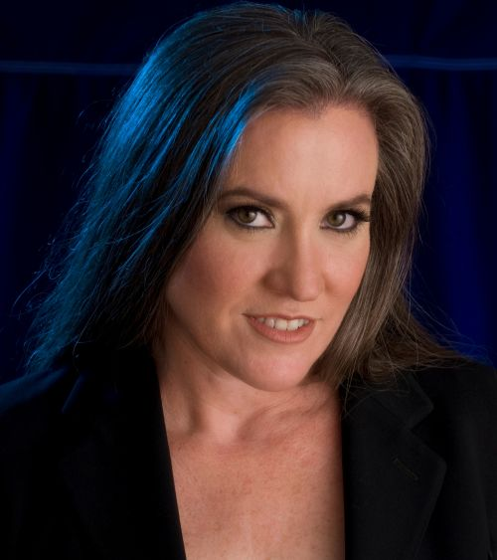
Susan Wright, M.A.
Susan is the spokesperson for the National Coalition for Sexual Freedom. She researches and publishes on violence and discrimination against BDSM practitioners, and she successfully directed the DSM-5 Revision Project that helped convince the American Psychiatric Association to depathologize consensual BDSM behaviors in 2013.
She can be reached at: Susan@ncsfreedom.org
Notes:
Susan was first published in the AASECT newsletter in 2003 with an article called “SM Resources” and was featured in the member spotlight in April 2014.

Slide 4
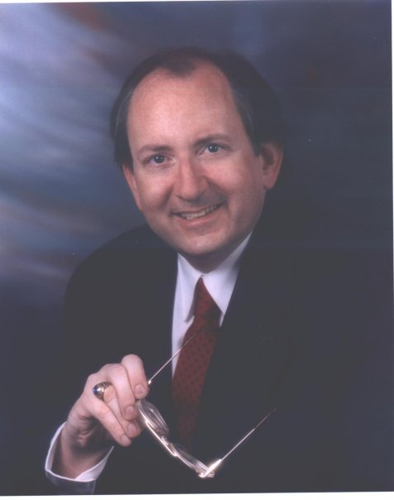
Russell J. Stambaugh, Ph.D
Dr. Stambaugh is a licensed clinical psychologist, researcher, and an AASECT Supervisor and Diplomate of Sex Therapy. His therapeutic specialties include individual adult psychotherapy, couples therapy, sex therapy, infertility, low sex desire, and compulsive sexual behavior. He has been studying sexual deviance, sexual variation, and the psychology of sexuality for 33 years. He can be reached at russell.stambaugh@gmail.com
Notes:
Russell has twice been awarded the Distinguished Service to AASECT Award, Chaired the AASECT AltSex Special Interest Group from 2011-2015, and became NCSF’s Kink Aware Professionals Advocate starting July 1, 2016.

Slide 5
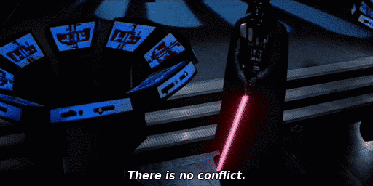
The presenters have no conflicts of interest.
Notes:
The funding for this study, such little of it there was, came from NCSF. NCSF itself is funded by private donors and kink social organization fund raisers.

Slide 6
Kink, Consent and Safety
Consent in Context
Notes:
Consent is a crucial concept in kink safety, but safety has many other dimensions. We begin with a schematic description of how safe paly happens.

Slide 7
Safe Play is Part of a Process
Negotiation, contracting and consent
Play
Aftercare and debriefing
Safety requires different considerations at different points in the process.
Ideal consent is continuous throughout: a loss of consent can be damaging at any stage.
Notes:
Negotiations are not just about safety, nor only about getting to consent. They are also about desire, friendship, establishing trust, self-exploration, and lots of things that can contest with safety.
But negotiations that work produce consent and a scope of planned play activities as their products. Negotiations require communication, but not just any communication. They work best for people who are self-aware, communicate clearly, care about their paly partners’ experiences, and trust others enough to expose their assumptions and check that their partner(s) really share them.
For Play to be safe, it must stay within the negotiated boundaries of consent, but for paly to be safe, there are many other conditions. It must occur in safe space between partners that continuously stay within their expertise and limits, and technical skills. For play to work, it must be sexy for both parties, and because kink is diverse, and there are lots of things to like and not like, it is often true that much discussion has to have occurred before partners elect to negotiate any scene.
Aftercare is about emotional safety, but it is also about seeking feedback and making this scene, and the next scene hotter. Often, it is about building trust that the partner really understood and accepted what happened in the scene. This is place where inner conflict about kink stigma gets discussed. Example, in humiliation paly, a submissive may want hurtful things to be said to them. In aftercare, metacommunication happens that helps diffuse the poison in humiliation paly that might make it harmful outside a carefully negotiated kink context. Often, its fun to pretend there is no context, but it is safer to acknowledge it.

Slide 8
NCSF Consent Statement
Consent is… an informed, voluntary agreement by two or more people to engage in a particular sexual activity or to enter into a relationship.
Ethical – mutual, informed, continuous.
Legal – consent, if you can prove it, is a fragile and weak defense in the US, and worse in Britain.
Notes:
NCSF’s Consent Summary is our review of Consent 101; the most basic statement.
Ethical: RJS added ‘continuous’, but you will see, later in the presentation, in many kink practices the implementation of continuous consent is very elastic for some players.
Legal: The first line of legal defense is to avoid the legal system altogether. Failing that, that you had consent when a complaint happens is difficult to prove, and even then constitutes a weal protection.
Many kink activities constitute assault in the eyes of the law. In many jurisdictions, you have no right to consent to criminal assault.
The definition of what is protected by consent is a matter of case law. There has not been much since Lawrence v Texas (2003) which decriminalized most non-commercial sexual conduct between consenting adults.

Slide 9

Consent is as Simple as Tea
Notes:
It’s a simple as tea. This illustration from the Boston tea Party museum shows our relationship between consent and tea is complex, not simple. “No, I do not want to have any tea!”
Also, when asked if you want tea, the questions naturally come next: “What kind of tea?” “Lemon or sugar?” “Hot or cold?” So why don’t we ask questions when it comes to sex, something much more important than tea?

Slide 10
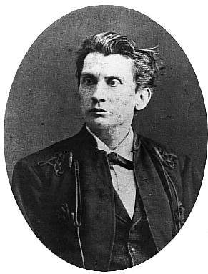
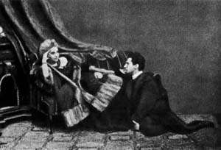
History
Leopold von Sacher-Masoch Venus in Furs (1870) First contract between Fanny and Leopold
Notes:
Leopold von Sacher-Masoch on the left, drew up the first masochistic contract in Venus in Furs, but had actually agreed to the same one earlier in his real life relationship with Fanny Pistor, a woman he sojourned with in Italy. They are seen relaxing together on the right.
He used similar contract again in his 12-year marriage to Aurora von Rumelin, in an attempt to level the social differences attending his aristocratic rank. He then repeatedly beseeched her to cuckold him, an act that would have caused her great legal vulnerability in Austrian divorce law, contract or not. So von Sacher-Masoch is not only the first example of a kinky contract, but an object lesson of the problems of submission between non-equals. After all that, he divorced her anyway. The mere presence of a contract does not make all things safe.

Slide 11
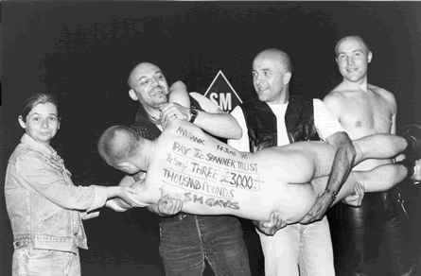
History—Cheque to The Spanner Trust

Slide 12
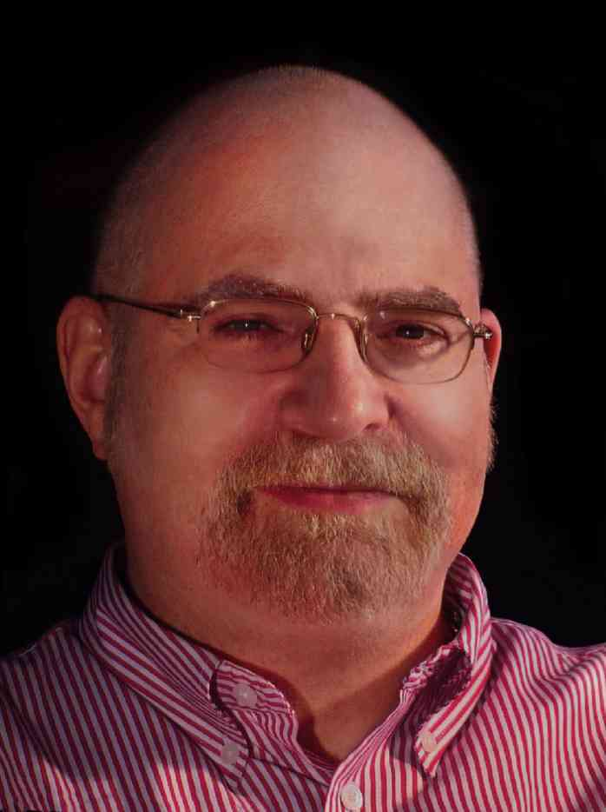
History
david stein Safe Sane and Consensual (SSC) (1983)
Notes:
david’s name is not mis-capitalized: it is a kink convention for submissives to use lower case for their names and personal pronouns. he created SSC as part of committee for The Gay Male S/M Activists purpose statement. The group looked at the fears they overcame to join up, and marketed to those. They selected the twin pillars of resistance due to stigma: mental health and legal sanctions. SSC went viral without benefit of the world Wide Web and persists to this day despite the fact that no kink group offers airtight safety nor pre-certified sanity for its members. david first disavowed his original construction, and then after many years of debate, eventually owned it again. This is a little like Thomas Jefferson denying the validity of the Declaration of Independence for a decade!

Slide 13
History
‘Operation Spanner’ Case in the UK (1987 - 1997)
Gary Switch’s Risk-Aware Consensual Kink (RACK) (1999)
Personal Responsibility in Consensual Kink (PRICK)
Notes:
In 1987, a local police group in northern England seized a VCR tape showing genital torture. They imagined they had a ‘snuff film’ and launched, in cooperation with Scotland Yard, launched Operation Spanner, a surveillance of a gay male BDSM group. Eventually they raided the group and arrested about thirty men. The authorities were dumbfounded when they learned the acts were all consensual, and fro 18 months, they struggled with how to prosecute. Eventually the prosecutor sized nineteen century case law that British citizens had no right to consent to assault. Masochist who consented to assault were charged as accessories to their own assaults! Into the early nineties, many of these men served long jail sentences as the case wound its way through appeals, eventually landing in the house of Lords where a panel of five lords ruled three to two that British Citizens had no right to consent to assault. A crucial argument in this case was that it would be impossible to prosecute cases of domestic violence if victims were required to cooperate. Eventually, the case was appealed to the European Union Court of Human Rights in Strasbourg where each of the 27 member nations at that time agreed that the UK had every right to legislate against assault. The upshot was the organization of the Spanner Trust pictured here, and the rapid organization of BDSM advocacy groups, including NCSF! There is a great summary of this on Elephant… with links there to stories of the Spannerman’s experiences. http://elephantinthehottub.blogspot.com/2013/05/normal-0-false-false-false-en-us-x-none.html

Slide 14
Qualified Consent
Safewords
Renegotiation during a scene?
Consent and Altered States:
Drugs
Subspace
Top Space
Triggering
Notes:
Gary Switch’s Risk-Aware Consensual Kink first posted on the TES (The Eulenspiegel Society) Friends list. It found instant traction there among edge players whose attraction to some activities was partly based on their lack of safety. Being risk-aware focused on the value of informed consent, rather than false notions of safety. About this time, sex educators had bailed on the concept of ‘safe sex’ too.
Personal Responsibility in Consensual Kink (PRICK) instead of Risk-Aware. This had limited acceptance, even among kink, where radical personal responsibility is widely understood, because it was seen as shifting too much responsibility onto the vulnerable. This is much the same argument as the rape culture backlash to the admonition not to wear short skirts.
Renegotiation is regarded by lifestyle educators as relatively risk behavior, because play alters frame of mind, because power has been exchanged and intensity of feelings may undermine consent. Of course, those are among the key reasons players want renegotiate.

Slide 15
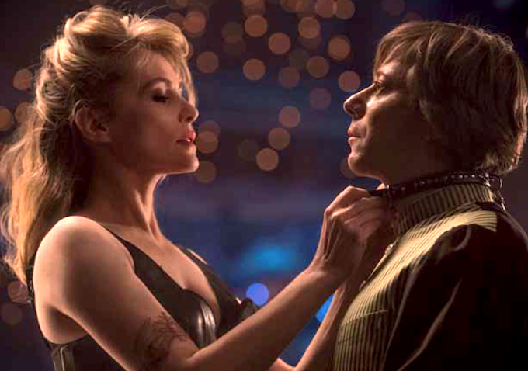
Seduced Consent
Notes:
Emmanuel Sevigny and Mathieu Amalric enact an intense seduced consent scene in Roman Polanski’s 2013 film, Venus in Fur.

Slide 16
Consent Variations
Kink as ‘Trust fall’
How do you know trust when you feel it?
Consensual Non-Consent
Risk is exciting
Surrender is proof of trust
Kink can be about pushing limits
Master/slave Relationships
The “Mindfuck”
24/7 Lifestyle Relationships
NCSF support for varied relationships
Notes:
Tops desire trusting submissives as proof of the tops’ excellence. Submissive want to be good bottoms. So kink is partly about a trust fall, and this militates against explicit consent.
This goes precisely to the epistemology of trust, and how individual participants know it when they feel it.
Consensual non-consent scenes are widely valued by some members of the kink community. 40% in our survey said they did them. 15% said they had consent violations in such scenes.. So they are risky but exciting for the reasons listed immediately above. Consensual non-consent means participants agree to give up the right to refuse activity n a scene, even when they do not know what may happen. Sometimes participants have ‘hard limits, which are adhered to, and soft limits which they may be forced to do during consensual non-consent. Sometimes submissives give up hard limits as an act of love, an attempt to prove themselves, or through bad judgment.
Master/slave relationships vary tremendously, but frequently involve giving up control of the slave’s behavior to the Master in global and arbitrary ways that go deeper than individual sex scenes. One of the characteristics of kinky folk is that they often find ways to eroticize, or saturate the mundane with meanings that conventional people, or even sex therapists might miss. The mind is the sexiest organ in the human body, and it goes many places for erotic and power exchange satisfactions. They like to institute “rituals” in their relationship that reinforce the power dynamic, often based on service from the submissive attending to the master’s needs.
The Mindfuck is legendary as a kind of epicurean terror in kink. It depends on a crafty top giving the impression they are violating the submissives limits while sticking to the letter of the law. For example, a slave who has a hard limit against knife play can be encouraged to imagine while blindfolded that the touch of a credit card is actually a knife. This may sound strange, but we vanilla people like movies like The Usual Suspects, Sixth Sense, or Memento. A kink erotica story of this type is Pat Califia’s short story ‘The Surprise Party’ in Macho Sluts.
24/7 Lifestyle relationships represent the ultimate in consensual non-consent, in which the slave gives up total control of their lives. Often the boundaries limit the relationship to times when the slave is not at work, or provide for time when they are visiting friends or family, but control can be total for extended periods. Thus can be very challenging for therapists who are schooled to value equality, mutuality, independence and differentiation that do not seem to apply in these relationships. The NCSF position is that all types of relationships should be supported, but nothing prevents any relationship, extreme or conventional, from being pathological or the appropriate focus of clinical attention. Cultural competence requires that therapists inform themselves about the practices of their clients. It is also true that some outlier practices are not easily researched, and even when clients are engaged in very typical kinky practices, therapy can require them to be articulate as possible about their experiences and desires.

Slide 17
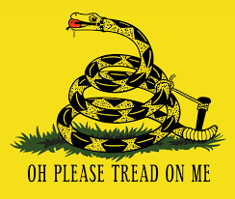
Misconceptions of 24/7 M/s Relationships
Notes:
Since someone asked, the red item in the rattler’s mouth is a ball gag, not an apple!

Slide 18
Community Attitudes
Klement, K, Sagarin, B, and Lee, E “Participating in a Culture of Consent May be Associated with Lower Rape-Supportive Beliefs.” The Journal of Sex Research, April 2016
NCSF’s Mental Health Survey
2012 Consent Counts Survey
2014 Consent Violations Survey
Notes:
Further reading about surveys of the kink community regarding consent and mental health include the above titles. Enjoy!

Slide 19
Safety in Kink
Safety around being out and joining
Safety around contracting consent and play
Safety discourse in the community
Specific safety mechanisms in BDSM social organizations

Slide 20
Issues Around Being Out
Not being out at all.
Out to a tiny groups of sexual partners
Double lives: out to some but not others, and not out to primary partners.
Joining BDSM social organizations
Overcoming resistance to voyeurism, exhibitionism, poly, and group rules.
Profiting form social opportunities, kink education, group safety procedures.
Safety risks and benefits from being fully out greatly depend on geography, occupational, ideological, and familial contexts.
Notes:
Most BDSM participants are not fully out. We are unlikely to reach those with surveys
People who keep their private life kinky, but do not connect with a kink community are also unlikely to fall in our sample. For these people, many kinds of social safety are easily managed, but they may face risks from technical issues about playing safely.
Many people are out on-line using screen names and avatars. These people are at least participating in on-line communities. They are exposed o kink educational efforts and community discussions, even if they are not prepared to play. This is about as much social participation as was possible before 1972.
Double lives generally involve deception and intimacy costs that therapists tend to frown on.
To actually join a BDSM organization, one must have one within geographic reach, overcome social reluctance and not be unduly afraid of meeting crazed deviants. Acceptance of voyeurism, exhibitionism, poly ideology, and any group rules,
Not everyone faces similar risk/reward opportunities in making these decisions.

Slide 21
Consent Violations Survey
National Coalition for Sexual Freedom

Slide 22
This project has been reviewed and endorsed by a community advisory board of the Community-Academic Consortium for Research on Alternative Sexualities (CARAS). This project has scientific merit, follows ethical guidelines for research, and avoids community harm in its design and methods.
CARAS: https://carasresearch.org
Notes:
NCSF encourages everyone doing research on kink, non-monogamy, fetishes, cross-dressing and paraphilias to run their questions through the CARAS review board.

Slide 23
Consent Violations in a BDSM Context
Our respondents overcame safety considerations about being out.
Fears of exposure
Concerns about voyeurism/exhibitionism
Social skills
Double life
Community affiliation
Unknown demographics of social organization participation
Notes:
Not everyone who likes kink identifies it as kink. Not safe to self-label due to stigma.
Not everyone who self-labels is willing to admit it to others.
Not everyone who is self-identified as kinky is willing to be out in a social group.
The safeties and dangers of a double life.
Social groups meets some needs better than others. Great for getting safety instruction, but better for finding paly partners for some kinks more than others.

Slide 24
The Consent Violations Survey asked about consent violations in a BDSM context including:
The severity of the violations
Who is being violated
Where they were violated
The relationship of those involved
The intent of those involved
The power dynamic at the time of the violation
Information from people who have been falsely accused
Information from people who have committed consent violations
Notes:
Launched in 2014. The National Coalition for Sexual Freedom gathered data through its first Consent Survey in 2012 in order to gauge attitudes about consent and consent violations within a power exchange context. Of those responding, 33% indicated that their pre-negotiated limit had been violated and/or their safeword was ignored during a BDSM encounter. We knew we needed to confirm our findings and get more detail on who, what, where, when, why and how consent violations are happening.

Slide 25
4,598 people began the survey…
Up to 210 people choose to not respond to some of the questions in the main question set.
This excellent click-through rate (95.5%) indicates people were highly motivated to respond on the issue of consent violations.
Notes:
Primarily online distribution through Coalition Partners and Supporting Members, then on to their members, on FetLife and announcements made on blogs and Leatherati, an online leather news source.
Initial data set took 15-20 minutes and for extended questions up to 45 minutes.
Shows our undeserved population is HIGHLY MOTIVATED to help make our lives better
The reported number of consent violations may under-count psychologically important non-consensual incidents, because anyone so troubled that they no longer participate in real life or online BDSM communities may not have seen the survey to participate in it. On the other hand, people who experienced consent violations were likely to be more motivated to respond simply because of the title of the survey.
When trying to make comparison between this survey and other measures of non-consent behavior, it is important to realize that to get a representative sample, it is necessary to have 50% or more of a sampled population respond. In this survey, we have no idea of the denominator underneath our 4,598 respondents. So this survey gives only an unscientific suggestion of the incidence or prevalence of non-consent relative to the population of kinksters who attend social organization events. It is, however, useful for making judgements about who reports and what they have reported.

Slide 26
Demographics
Consent Violations Survey
Notes:
The survey was posted on Survey Monkey from January to June 2014.

Slide 27
Consistent with other NCSF surveys:
Nearly 90% of the respondents live in the United States
Nearly 90% were Caucasian
70% aren’t out to their family or coworkers about their BDSM activities.
65% between the ages of 25-50
40% identified as heterosexual while 60% of the participants identified as a sexual minority,
Notes:
The results on demographics and violations are the same as previous surveys – but with the Consent Counts Survey we got 72% through FetLife. This time less than half came from FetLife. That indicates we’re reaching a good cross-section
When compared to the NCSF Violence & Discrimination Surveys 1998 and 2008, and the Consent Counts Survey done in 2012.
Majority are not out and therefore not likely to disclose to you easily. They will ask you probe questions to see if you respond.
Majority are sexual minorities, which carries a higher level of stigma and subsequent discrimination.

Slide 28
However, more women than men responded:
Notes:
Gender breakdown – NOT similar to previous NCSF surveys, which was closer to 50/50 with 2-6% trans
This may be due to the fact that the female respondents experienced a higher rate of consent violations (as is typical in the general population) and therefore there was a higher motivation for women to take a survey about consent violations.
Opt-in Survey – these numbers only describe this sample, which is taken from people who at least have some access to the organized BDSM community online.

Slide 29
Nonconsensual Touching at BDSM Events
Consent Violations Survey
Notes:
Social boundary violations are the gateway to consent violations. That’s why BDSM groups are vigilant about rules against touching without permission.

Slide 30
Nearly 36% of the respondents reported being touched without permission at a BDSM meeting, club, munch, party or event.
Notes:
39% of the females and 28% of the males were touched without permission at a BDSM club or event. A clear violation of social group safety policies.
Sexual minorities - over 42% of those who are gender queer, transgender, or other gender identities were touched, while heterosexuals were less likely to be touched without permission
Essential to reinforce people’s social boundaries –red flags for predators: persistent questioning, leaning in or sitting too closely, “handsy” and touching without permission. Predators often look for people who can’t or don’t reinforce those social boundaries.
These results are important because they show that existing community rules and boundaries offer some protection relative to the general society’s rules, but that the kink communities still transmit some of the same stigma and vulnerabilities, albeit to a lesser extent. These results parallel those of Conley, T, Moors, A, Mastick, J and Ziegler, A The Fewer the Merrier?: Assessing Stigma Surrounding Consensually Non-momogamous Romantic Relationships in Analyses of Social Issues and Public Policy Vol 00.No )), 2012, p 1-29. Conley et al showed that CNMists had less stigmatized attitudes towards their own behavior than conventionals, but still held some stigmatized attitudes towards their preferred behavior.

Slide 31
Table 1. Touched without permission at an event | Responses–1,603
Hair touching | 1% (22)
Hug | 6% (91)
Multiple violations/ multiple times | 10% (162)
Hit by a toy/hand | 13% (212)
Nonsexual touch | 32% (506)
Sexual touch | 38% (610)
Notes:
Types of touch
10% were multiple violations, indicating some people are more vulnerable to social boundary violations
More than 1/3 were sexual in nature. But even hugs can be a violation, which is not something the general public knows.

Slide 32
Consent Violations during BDSM Activities
Consent Violations Survey
Notes:
Now we get to violations that happen during negotiated behavior, where some part was consensual but other parts weren’t.

Slide 33
29% of the respondents reported their pre-negotiated limits and/or their safeword have been violated in a BDSM context.
31% of the self-identified females reported their consent was violated, while 13% of the males reported their consent was violated.
Females were 1.65 times more likely to have had a consent violation in a BDSM context than were males (X²=52.817, df=4, p=.000).
Notes:
(see Figure 4) 1,307 of the 4,503 respondents
(See Table 9). 747 females and 213 males
This self-selected sample does correspond to the Consent Counts Survey, which drew from a largely FetLife population - 30.1% had a pre-negotiated limit violated. That survey didn’t announce it was looking into violations and only asked 2 questions about it.

Slide 34
Sexual Assaults in BDSM scenes
9% of the people within this survey reported experiencing nonconsensual oral, anal or vaginal sexual experiences during BDSM.
Being non-consensually penetrated in the vagina by a penis, finger or dildo was the largest reported category among the participants whose consent was violated (29%).
Notes:
Sexual assaults? 400 out of 4511 people.
Only 2% or less of the total survey respondents had their consent violated by each of the following BDSM activity: flogging, bondage, knifeplay, spanking, gags, watersports and blindfolds.
You need to help people learn to include negotiating sexual touching/sex and edge play like punching/slapping because those are the most common methods of violating consent.

Slide 35
Compared to General Population
Consent Violations Survey
General Population Surveys
12.5% women (314/2511)
3% men (52/1651)
10.6% gender queer (24/226)
8.7% transgender (10/115).
11-18% of women
1-3% of men
Notes:
While this still is too high, sexual assault within the BDSM community is no higher than among the general population.
Basile, Chen, Black, & Saltzman, 2007; Black, Basile, Breidling, Smith, Walters, Marrick, Chen, & Stevens, 2011; Tjaden, & Thoennes, 1998.
These are fairly non-scientific comparisons, given that we do not know how intensely self-selected our sample is.

Slide 36
What Happened?
Consent Violations Survey

Slide 37
Severity of Consent Violations
Half of the people who were violated said it wasn’t bad enough to report to the police or to community organizers.
96 people (2% of the survey sample) reported an injury that required some kind of medical attention.
One-half of 1% (23 people) reported receiving a serious physical injury that was life-threatening or serious enough to cause dysfunction in an organ or limb.
Notes:
½ of the violations weren’t serious. Very few reported serious injury
Emergency care - 33 people went to the hospital and only 4 people weren’t happy with how helpful the hospital was. Hospitals are known for asking persistent questions about abuse when there are suspicious injuries and therefore were typically seen as helpful by people who were violated.
Counseling - 144 people (14% of 1,039) accessed victim services, with 75% of those people seeing a mental health care provider. You are on the front lines for people who have been violated. This survey helps provide context for your clients’ reports.

Slide 38
Negotiation
Table 8. How did you negotiate? | Responses–1053
Wasn’t given chance to negotiate | 2% (24)
Multiple negotiation methods used | 3% (30)
Didn’t negotiate | 7% (77)
Online negotiation | 10% (108)
In relationship/no negotiation for scene | 17% (176)
In person negotiation | 60% (638)
Notes:
Negotiation – the Importance of Negotiation in helping to prevent violations
One in 4 people reported that they did not negotiate the BDSM interaction for a variety of reasons: either they weren’t given a chance (2%), or they chose not to negotiate (7%), or they were in a relationship with previous experience together and did not negotiate the interaction that involved a consent violation (17%).
Negotiation helps, but does not negate power imbalances.

Slide 39
Why renegotiating to add activities to a scene is problematic:
23% said the person who violated their consent attempted to renegotiate their limits (234 of 1,047 responses).
In only half of those cases, the person whose consent was violated reported they were of sound mind during the attempted negotiation.
Notes:
(see Figure 6). Re-negotiation
A red flag for predators and manipulators is re-negotiating to ADD activities to the scene. Advise against allowing this to happen. Re-negotiating to REMOVE activities should always be allowed.
This provides crucial feedback for social group norms and trainings for socializing new members.

Slide 40
Why did it happen?
Table 4. | 1018 Responses
It was because of alcohol | 27 (2%)
It was an accident | 58 (6%)
It was part of our dynamic | 71 (7%)
Lack of skills or knowledge | 103 (11%)
Misunderstanding or miscommunication | 149 (15%)
Attacked by a predator | 265 (26%)
Manipulated or coerced | 345 (33%)
Notes:
We asked those who were violated why it happened? (See Table 4). This is a much more nuanced view of consent violations than the results of NCSF’s 2012 Consent Survey, in which 33% of the respondents reported their pre-negotiated limits and/or safeword were violated.
Between 1,077 and 991 people responded to the detailed question set that asked about one specific consent violation they have experienced. That means 232 people declined to answer any questions in the detailed question set even though they said their pre-negotiated limits and/or safeword were violated.
Keep in mind that an accidental violation or a miscommunication can be as damaging physically and emotionally as one that is done intentionally.

Slide 41
From Victim’s Perspective:
From Violators Perspective:
Table 4. | 1018 Responses
It was because of alcohol | 27 (2%)
It was an accident | 58 (6%)
It was part of our dynamic | 71 (7%)
Lack of skills or knowledge | 103 (11%)
Misunderstanding or miscommunication | 149 (15%)
Attacked by a predator | 265 (26%)
Manipulated or coerced | 345 (33%)
Table 21. | 97 Responses
It was because of alcohol | 1 (1%)
Renegotiation | 3 (3%)
Thought I could get away with it | 4 (4%)
Got caught up | 6 (6%)
Lack of skills or knowledge | 13 (14%)
It was an accident | 18 (19%)
It was part of our dynamic | 23 (24%)
Misunderstanding or miscommunication | 29 (30%)
Notes:
From the different perspectives – Victim vs. Violator
Color coded to see the difference between accident (6% vs 19%)
Victim: 40% said the motivation was relatively benign – accident, miscommunication/ 60% reported a predatory intent behind the violation
Violator: only 10% admitted to willful violations. Remember that 23% reported that the Top attempted to re-negotiate the scene - which could have been seen by the victims as manipulation/coercion, predation, or caused a misunderstanding/miscommunication or accident.
These comparative results mirror the victims’ and violators’ perspectives in conventional rape research where 10-20:1 ratios of reports to admissions are common.

Slide 42
Who is Violating Consent?
Consent Violations Survey

Slide 43
Demographics
78% (841 of the violators) were male, while 19% (204) were female.
65% of the violators were identified as heterosexual while only 40% of the sample self-identified as heterosexual
Heterosexuals were violated at the lowest rate—18%.
Notes:
(see Figure 8). For 1 in 3 (344 people) it was their first time playing together, while 40% (422 people) had played with them more than 5 times when it happened. This busts the sexist notion that violators are all male. It also shows that within this sample the heterosexuals were a more protected class and were more prone to being the aggressors.
Nearly half said the person who violated their consent was a lover, play partner or partner (see Table 12).

Slide 44
Newbies at risk
1 in 4 people say their pre-negotiated limits were violated before they started to participate on BDSM websites or before attending a BDSM meeting, club, munch, party or event.
3 in 4 of first consent violations occur before someone participates in BDSM groups and events or within the first three years of going to BDSM groups and events (775 people).
Notes:
(see Table 16). Newbies are in the “red zone” for violations and need to be made aware of the risks and given extra support and education about informed consent by community groups and events.
¾ of the reported violations happened to someone before or in their first 3 years in the organized BDSM community. Therapists and educators are on the front lines - often helping people who aren’t in the BDSM community getting kink education.
Note that this effect is exaggerated if we later find that only a small proportion of all people who do BDSM behaviors are part of the existing communities we surveyed, or if the existing BDSM social organizations get a sudden influx of new members whose primary preparation comes from sources like the 50 Shades series that are not good socialization to the existing community standards.
This was the last slide we presented #AASECT16.

Slide 45
Violators
1 in 3 people know of someone else who was violated by the same person who violated their safeword or pre-negotiated limits.
1 in 5 people reported that the person who violated their consent held a leadership role in a BDSM-leather-fetish group or event at the time it happened.
Notes:
Serial predators – typically we call serial predators people who have been reported by multiple people as having violated their consent. It’s noteworthy that community organizers who are in a position of power can and do abuse that power.
Civil liability for group and events: see NCSF’s Liability Issues for Groups. This result indicates that self-policing efforts could be heightened to remove serial violators from kink events, and that those self-policing efforts should apply equally to volunteer organizers and presenters who have violated someone’s consent.
In order for the community to work, it must work for everyone. That means that groups won’t hear about consent violations if complainants believe the violator holds closer personal relationships with the event organizers than themselves. This remains true even if the potential complainant is only imagining this and it isn’t actually true, so clear and impartial mechanisms for how groups deal with consent violations need to be set in place. (See NCSF’s Guide for Groups, Dealing with Consent Violations, and Drawing the Line.)
We have no data from this survey, but it may be presumed that the more systematic power violation is, the more likely it is to leave lasting consequences that require treatment. Therapists are on the front lines in responding to these types of events.

Slide 46
Frequency of Violations
Consent Violations Survey

Slide 47
60% of the people who reported having their pre-negotiated limits violated were violated two or more times
Notes:
See Figure 9. – 2 or more times. 2/3 of the respondents who said their consent was violated said it had happened 2 or more times.
Re-victimization – these are our most vulnerable people. The majority are a member of a marginalized group like transgender people or pansexuals. For more than 2 violations: only 28% were heterosexual compared to 41% in the general survey, and 10% were gender queer and 6% were trans compared to 5% and 4% in the general survey. More research is needed on this issue so educational and social groups can be of better service.
Groups are starting to assign a staff member to monitor the negotiations of people who report multiple consent violations to ensure equality is respected and reinforced by the group culture.

Slide 48
Nearly half who reported their consent was violated within a BDSM scene or relationship reported they had been sexually assaulted as an adult outside a BDSM context.
Persons who had been sexually molested as a minor were 1.53 times more likely to have had their consent violated within a BDSM context (X²=40.935, df=1, p=.000).
Persons who had been sexually molested as an adult were 2.19 times more likely to have had their consent violated within a BDSM context (X²=130.255, df=1, p=.000)
Only 26% of those people whose consent hasn’t been violated have been sexually assaulted as an adult outside a BDSM context.
Notes:
Sexually assaulted as an adult (608/1,309 respondents)
People who have had their consent violated 3 or more times in BDSM context are vulnerable in ways that are not being countered by educational messages, the SSC and RACK philosophies, safe calls, references, etc.
Child abuse ups the odds of a violation, but adult sexual abuse is a bigger risk factor – Ask about prior instances of abuse and assault to help determine if boundary reinforcement and self-protection education can be helpful when clients are doing BDSM.
Van der Kolk, Bessel A. MD. "The Compulsion to Repeat the Trauma: Re-enactment, Revictimization, and Masochism", Psychiatric Clinics of North America, Volume 12, Number 2, Pages 389-411, June 1989.http://www.cirp.org/library/psych/vanderkolk/

Slide 49
Significant at .05*, .01**, or .001***
Notes:
Males and trans child victims are more likely to experience consent violations in this sample.
Heterosexuals report being at the highest risk when they’ve experienced child abuse –likely that serves to counter their inherent power from being “normative”
Tops, for the same reason – perhaps it counters their inherent power position within the BDSM community

Slide 50
References for Play Partners
Notes:
Considering how often kinky educators recommend getting references as a way to screen partners, it’s notable that only 28% of those who were violated asked for references prior to the scene. Considering the importance the community places on references, this may indicate the danger of NOT asking others about your potential play partner.
Also of note is that the references they did get were not more useful in predicting consent violations: 82% of the total references were positive. However this survey doesn’t capture all of the scenes that didn’t take place because there were poor or bad references.

Slide 51
Reporting Consent Violations
Consent Violations Survey

Slide 52
Low Reporting Rates:
Only 29 people reported the violation to the police.
90% of the people who spoke to a service provider said they were helpful. This should encourage kinky people to report crimes to victim services and let the professional advocates help them report it to the police, if they choose to do so.
Notes:
This is much worse than traditional reporting rates: according to the Justice Department’s National Crime Victimization Survey: 2008-2012, sexual assault is one of the most under-reported crimes, with 68% of sexual assaults not reported. The under-reporting found in this survey may be due in part to the fact that the majority of kinky people are not out due to discrimination. The Justice Department, National Crime Victimization Survey: 2008-2012.
The largest percentage (23%) of NCSF’s 2015 Incident Reporting & Response cases involved assisting kinky people in accessing victim services, reporting an assault, sexual assault, blackmail or stalking to the police, and obtaining restraining orders.
NCSF: https://ncsfreedom.org/key-programs/incident-response/incident-response.html

Slide 53
Why didn’t you report?
Table 20. | Responses
It wasn’t bad enough to report | 46% 460
It could have caused too much trouble for me | 18% 181
Didn’t think police would believe me/police mistrust | 12% 123
Confused | 12% 116
I didn’t want to get them in trouble | 5% 45
Too scared | 4% 36
I was okay with it | 4% 36
Notes:
If you remove the respondents who stated the consent violation was not serious enough to report (460 people), 501 people chose not to report for other reasons.

Slide 54
Reporting to Group Organizers
29% said the consent violation happened at a BDSM group or private play party
Only 1 in 4 reported it to the organizers.
Of those, 1/3rd said the organizers weren’t helpful at all.
Notes:
308 people said it happened at a party or event. Groups can do a better job to encourage attendees to report consent violations and in dealing with consent violations. This is much higher than we want to see. It could be because events are where people are meeting new people and experimenting with new skills/desires. NCSF educated 2 dozen groups last year on how to deal with consent violations in a way that doesn’t further re-victimize the person who was violated. We are currently releasing our Trauma Reaction booklet to educate about the various ways people respond to trauma.

Slide 55
False Accusations
Consent Violations Survey
Notes:
This is such a hot button topic within the BDSM community. People are quick to defend their friends against accusations of consent violations. As we know, even people who are well-respected can commit sexual violence. In fact, some perpetrators admitted they did it because they “thought they could get away with it.”

Slide 56
3% or less rate for false accusations was reported in regards to:
nonconsensual touching at kink events
violating someone’s safeword
violating someone’s pre-negotiated limits
Notes:
That is a much smaller percentage than is commonly believed, likely because each false accusation attracts a lot of attention (much like the recent Rolling Stone article) while one in three of the kinky people who were violated say they never told anyone about what happened.
Coronel, Sheila; Coll, Steve; Kravitz, Derek, April 05, 2015, “Rolling Stone and UVA: The Columbia University Graduate School of Journalism Report: An anatomy of a journalistic failure” Rolling Stone. http://www.rollingstone.com/culture/features/a-rape-on-campus-what-went-wrong-20150405

Slide 57
Only 7 people reported they had been falsely accused and reported to the police: 1/10 of 1% of the total.
Only 16 people were falsely accused twice (or more) of violating a safeword (0.3%).
And 30 people have been falsely accused twice (or more) of violating someone’s pre-negotiated limits (.7%).
Notes:
As the seriousness of the accusation rises, the percentage of false reports shrinks exponentially. This indicates how rare multiple false accusations are and that group organizers should take it very seriously when multiple people accuse one of your members.
As far as the respondents who reported their consent was violated, 14% (140 people) say they were accused of making a false accusation when they talked about what happened.

Slide 58

If you have any questions regarding the data in this survey, please contact NCSF at:
susan@ncsfreedom.org

Slide 59
Image Credits
https://upload.wikimedia.org/wikipedia/commons/f/ff/Leopold_von_Sacher-Masoch,_portrait_2.jpg
https://upload.wikimedia.org/wikipedia/commons/7/7c/Leopold_von_Sacher-Masoch_with_Fannie.gif
http://www.leatherati.com/legacy-images/6a0120a64cc92c970c01543513ecda970c-pi.jpg
Notes:
These slides and note are copyrighted material by Russell J Stambaugh, PhD, Susan Wright, MA, and Derrell Cox II, MA, and NCSF, June, 2016. Automatic permission is automatically given for fair use and educational applications provided the authors are credited.

