Slide 1

Media Training
For Mental Health Professionals

Slide 2
Prepared by:
Susan Wright, M.A.
Russell Stambaugh, Ph.D.
Stephanie Buehler, MPW, PsyD, CST-S

Slide 3
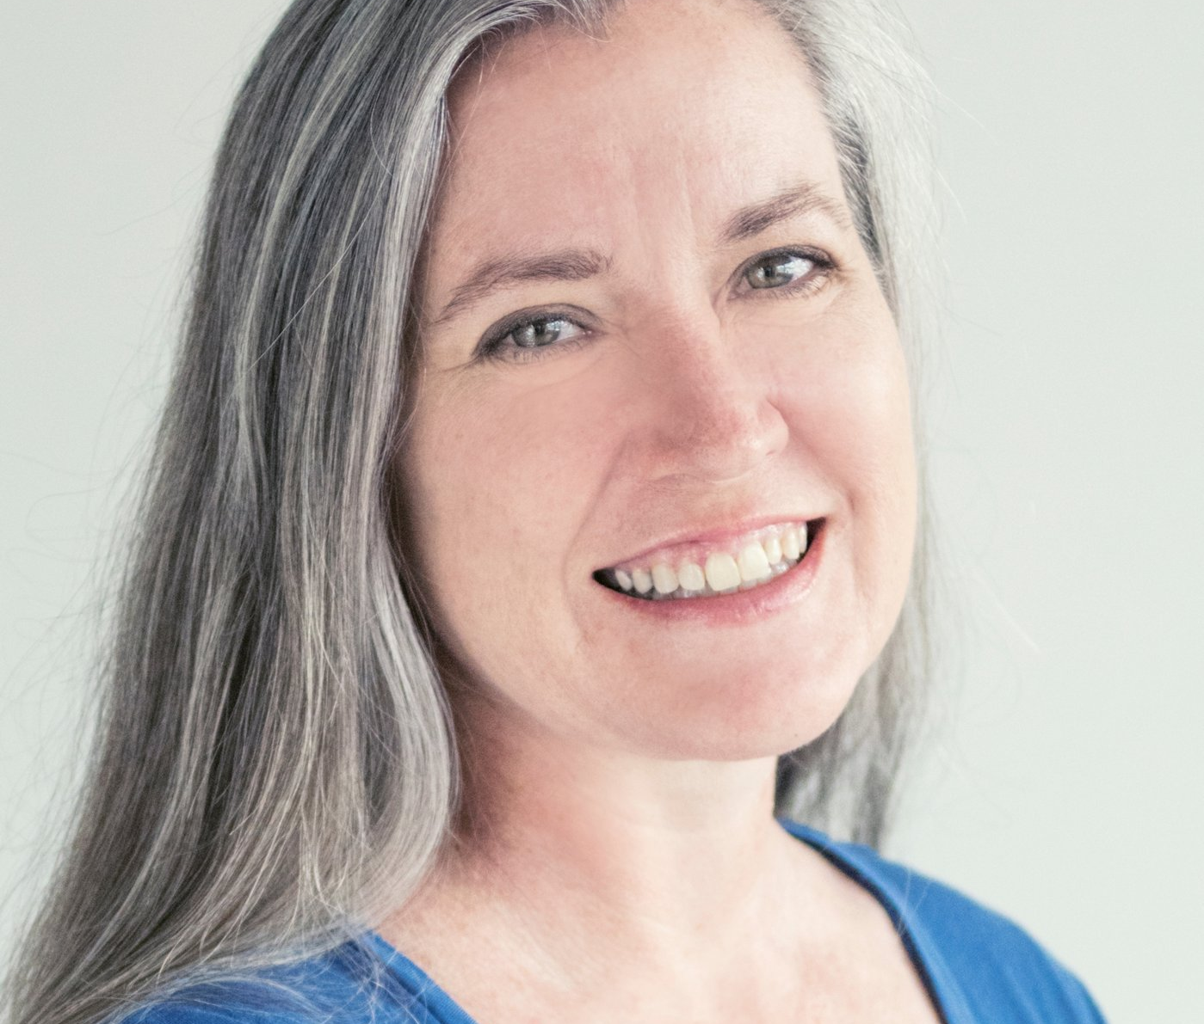
Susan Wright, M.A.
Susan is the spokesperson for the National Coalition for Sexual Freedom. She has 20 years experience in crisis management and in dealing with the media, and has given hundreds of interviews with TV, newspaper and Internet media outlets. She trains groups and individuals on how to give media interviews and control their own messaging.
She can be reached at: Susan@ncsfreedom.org

Slide 4
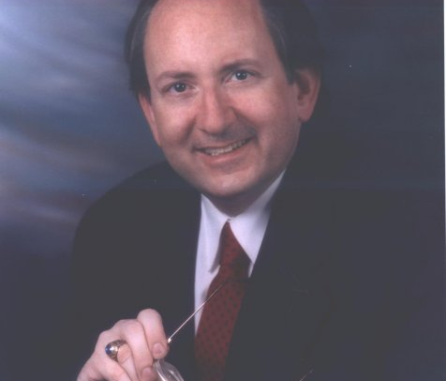
Russell J. Stambaugh, Ph.D.
Dr. Stambaugh is a licensed clinical psychologist, researcher, and an AASECT Supervisor and Diplomat of Sex Therapy. His therapeutic specialties include individual adult psychotherapy, couples therapy, sex therapy, infertility, low sex desire, and compulsive sexual behavior. He has been studying sexual deviance, sexual variation, and the psychology of sexuality for 33 years. He can be reached at russell.stambaugh@gmail.com

Slide 5
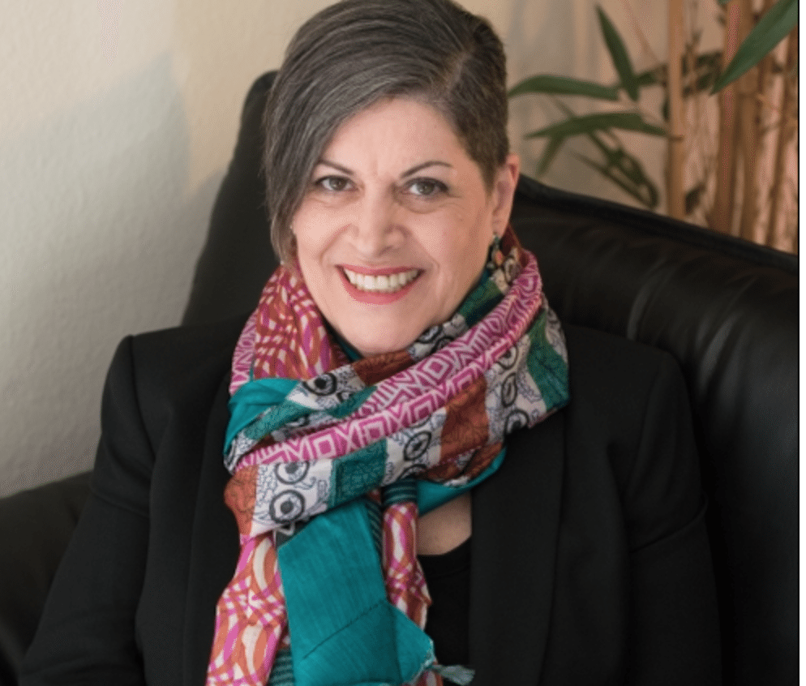
Stephanie Buehler, MPW, PsyD, CST-S
Dr. Buehler is a licensed psychologist and certified as a sex therapist and supervisor by AASECT. She attended UCLA, USC, Pepperdine University, and California School of Professional Psychology. She is the author of a few books, most recently What Every Mental Health Professional Needs to Know about Sex, 2nd Edition. She has spoken at major conferences across the country and around the globe–and at small support groups right here in Orange County.
She can be reached at dr.stephaniebuehler@gmail.com

Slide 6
Outline of Media Training
1. Ethics & the Media
2. Sex & the Media
3. Types of Media
4. Interview Tips
5. Sound Bites
6. Practice!
Notes:
Practice is opt-in

Slide 7
Ethics & the Media
The APA on ethics and the media:
  What is my role and the nature of my relationship with the individuals and groups involved?
  What degree of control will I have over the final product?
  How do the interests of the individuals and groups involved with the project align?
  What am I able to say based upon the limits of the available data? The Goldwater Rule.
  http://www.apa.org/monitor/2008/04/ethics.aspx
Notes:
It is important for psychologists in these instances to think through how the different ethical obligations are weighed and balanced against one another, especially when there is reasonable likelihood that competing obligations may conflict. It is likewise important that psychologists engage in a process of informed consent and clarify how conflicts will be resolved and whose information will be kept confidential.
The less control that a psychologist has, the more caution is in order. Research into what other projects a producer has done can help assess how responsibly the producer is likely to handle sensitive material. Establishing relationships with a producer over time can increase the level of trust and confidence. At the first encounter with a producer or program, be mindful that the influence you exert over the final product may be exceedingly limited.
Principle A in the Ethical Principles of Psychologists and Code of Conduct (2002) is Beneficence and Nonmaleficence: Do good and do no harm. Do not assume that those in the media with whom you work share this ethical principle and be aware of possible areas of tension between your goals and other participants' goals for the project.
Psychologists are frequently asked to comment on individuals and events that have garnered the public's attention. Ethical Standard 9.01, Bases for Assessments, makes clear that psychologists offer opinions "on information and techniques sufficient to substantiate their findings" and that "psychologists provide opinions of the psychological characteristics of individuals only after they have conducted an examination of the individuals adequate to support their statements or conclusions."

Slide 8
Ethics & the Media
AASECT Code of Ethical Conduct and its implications for the media:
  Client welfare first
  That doesn’t mean doing what your client wants you to
  Disguising case material can pose risks for innocent bystanders
  Reasonable care and concern about the field
Notes:
Russell – do you want to add more about this in the notes?

Slide 9
Sex & the Media
Giving an interview about sexuality can be challenging:
  Tendency to repeat stereotypes
  Reinforcement of mainstream, conservative views
  Inherent bias towards sensationalism
Notes:
The chips are stacked against us when we try to talk knowledgably about sex in the media. Even if you get a sympathetic reporter, their editor could think the opposite and put a Headline on the article and cut certain pieces to “make it more neutral” which means remove any sex-positivity from it.

Slide 10
Sex & the Media
Stay within your legitimacy
  Know your own expertise
  Refer reporters to others if it’s not your expertise
Notes:
You can do more harm than good talking about things you don’t have a complete understanding of. For example, you may be sympathetic about people who do BDSM or cross-dressing, but if your only experience with it is one or two couples, then you have to be aware you’re speaking from a very limited knowledge set and not to generalize. Often you end up repeating the stereotypes that others are trying to dispel.

Slide 11
Sex & the Media
    Danielle K Kilgo, Summer Harlow, Víctor García-Perdomo, Ramón Salaverría (2016). A new sensation? An international exploration of sensationalism and social media recommendations in online news publications. Journalism, Dec. 30, 1-20.
  Lukas Otto, Isabella Glogger, Mark Boukes (2016). The Softening of Journalistic Political Communication—A Critical Review of Sensationalism, Soft News, Infotainment, and Tabloidization and a Comprehensive Framework Model. Communication Theory. doi:10.1111/comt.12102
Notes:
The well-known phrase ‘if it bleeds, it leads’ describes the sensational approach that has penetrated the history of news. Sensationalism is a term without complete consensus among scholars, and its meaning and implications have not been considered in a digital environment. This study analyzes 400 articles from online-native news organizations across the Americas, evaluating the sensational treatment of news categories and news values, and their associated social media interaction numbers on Facebook and Twitter. Findings suggest that ‘hard’ news topics like government affairs and science/technology were treated sensationally just as often as traditionally sensationalized categories like crime or lifestyle and society. In addition, audiences are not necessarily more likely to respond to sensational treatments. This study also finds that online-native news organizations use sensationalism differently, and there is significant variation in publications from the United States, Argentina, Brazil, and Mexico.
Despite the scholarly popularity of important developments of political communication, concepts like soft news or infotainment lack conceptual clarity. This article tackles that problem and introduces a multilevel framework model of softening of journalistic political communication, which shows that the 4 most prominent concepts—(a) sensationalism, (b) hard and soft news (HSN), (c) infotainment, and (d) tabloidization, and, additionally, (e) eroding of boundaries of journalism—can be distinguished in a hierarchical model. By softening, we understand a metaconcept representing developments in political journalism that are observed on different levels of investigation, from journalism as a system (macrolevel) down to single media items (microlevel).

Slide 12
Types of Media
What are your goals in being interviewed?
  Self-promotion
  Normalizing sex positive values
  Advancing the field
  Protecting sexual minorities
  Others?
Notes:
Determine your goal to help you decide which media you choose to do and not do. You goals can also help shape your message. If your goal is to get your name out there, then being used that way, then you may be disappointed. But if your goal is to frame your conversation to promote a healthy sexual society, that’s a success

Slide 13
Types of Media
Proactive
  Publicity efforts via press release or PR firm
Reactive
  Responding to unwanted media exposure
Expert Source
  Providing background info for story
Notes:
1. Proactive - PR firms can help publicize your book or seminars. We suggest PR Newswire for an independent press release distributor. It costs a significant amount, but it’s the only thing we’ve found that really works.
2. Reactive – You may be called upon to respond to someone else’s crisis – a closed club or sexual scandal. If you’re the one in a crisis, it’s not easy to do alone. Contact NCSF for help – professors are being targeted for what they say in class. You can be attacked for something you say online. Anti-sex groups like the former Moral Majority, now called the National Center on Sexual Exploitation, are targeting groups that present sex-positive information. We suggest you put out a statement rather than try to speak in your own defense to be sure you aren’t taken out of context.
3. Expert Source – If you get your name out there, then they will call you as the expert they can speak to. We know journalists look at our KAP Directory to find experts who can speak on non-monogamy, BDSM, cross-dressing, fetishes and sexual topics in general.

Slide 14
Types of Media
Print – newspapers and magazines
Online publications – Salon and The Atlantic to blogs
Podcasts – audio and video
Radio
Television
Notes:
You have to adjust your message depending on the type of media you’re doing. With print, only one or two of your soundbites will be included, so you don’t want to ramble or ad lib because they will include the most off-the-cuff statement you make because it sounds the catchiest. With online publications, you will have to give more background info to help support their article. You can have your soundbites in front of you when doing these kinds of interviews, to help you stay on track.
Podscasts, Radio and Television are completely different. You need to be very comfortable with your soundbites and your message. There are additional considerations because of the way you speak – it’s always best to slow down during a taped interview. People tend to rush their words when they’re nervous. Radio and television have the added pressure that you can’t strike something off the record once you’ve said it. If you’re going to be on TV, I suggest getting a training on how to present yourself.

Slide 15
Types of Media
Sex-Positive –Cosmopolitan, Slate, Jezebel
Sex-Negative – Fox News, CNS News, Baptist Press
Local – Fox and Network affiliates, weekly alternative paper
National – NY Times, USA Today, Reuters, PBS
Cable – CNN, MSNBC, comedy shows
Notes:
Even with supposedly sex-positive media, like Broadly and Vice, can do hatchet jobs and go after some aspect of the community. Their writers are all free-lance so they have to turn in something that catches their editor’s attention to get a sale.
You have to gauge your message depending on what type of media outlet you’ll be interviewing with. PBS will want to focus on different things that your local Fox affiliate, which is usually responding to some perceived outrage.

Slide 16
Types of Media
  Always Google the Reporter!
    Hard news
    Lifestyle articles
    How-to articles
Notes:
You can find out what kinds of articles the reporter has written before. You can check for tone and content, whether the headline matches the content and whether there is any inherent bias that is displayed.

Slide 17
Types of Media
Learn to crawl before you start to run!
  Start with written questions
  Then phone interview with sound bites in front of you
  Then in-person interview
  Then radio interview
  Then television interview
Notes:
If you jump into a TV interview, you will never want to do another interview! Work your way up to the tricky stuff. Asking reporters to submit their questions via email is perfectly acceptable.

Slide 18
Types of Media
Create a Media Kit to attract the kind of media you want
  NCSF’s Media Kit https://ncsfreedom.org/press/media-kit.html
  Stephanie Buehler’s Media Kit http://thebuehlerinstitute.com/wp-content/uploads/2013/10/Media-Kit-2016-2017-1.pdf
Notes:
Your media kit states your case for what kind of interviews you can do and what you can offer to reporters

Slide 19
Types of Media
James Curran, Shanto Iyengar, Anker Brink Lund, Inka Salovaara-Moring (2009). Media System, Public Knowledge and Democracy: A Comparative Study. European Journal of Communication, Vol. 24(1): 5-26.
Robert G. Picard (2014). Twilight or New Dawn of Journalism? Evidence from the changing news ecosystem. Digital Journalism, Vol. 2(3): 273-283.
Notes:
This article addresses the implications of the movement towards entertainment-centred, market-driven media by comparing what is reported and what the public knows in four countries with different media systems. The different systems are public service (Denmark and Finland), a `dual' model (UK) and the market model (US). The comparison shows that public service television devotes more attention to public affairs and international news, and fosters greater knowledge in these areas, than the market model. Public service television also gives greater prominence to news, encourages higher levels of news consumption and contributes to a smaller within-nation knowledge gap between the advantaged and disadvantaged. But wider processes in society take precedence over the organization of the media in determining how much people know about public life.

Slide 20
Interview Tips
You don't have to answer the interviewer's exact question.
Notes:
This is the key to dealing with the media. From Kindergarten we are trained to answer people’s questions. But an interview is not a conversation. You aren’t there to convince them of anything. You’re talking to them in order to get your message broadcast. For example, if they ask, "What do you think when people say you're eroticizing violence?" give one of your sound-bites: "Kinky sex is consensual because at any time the participants can stop what's happening."

Slide 21

For example…
The reporter asks:
“Isn’t it risky for couples to open up their relationship and bring someone else into their sex lives?”
You can say:
“Couples involved in open relationships tend to get a lot of experience with communicating their desires, feelings, and boundaries. It's been well-established that good communication builds healthy relationships.”
Notes:
Rather than talk about the level of risk that opening a relationship entails – because each relationship is unique and this is not an easy question to answer generally – how much risk is too much risk for a couple? How do they evaluate that? Jump to the conclusion – that it takes a lot of communication to open up a relationship, and that’s the important part.

Slide 22
Interview Tips
You don't have to answer the interviewer's exact question.
Notes:
This is the key to dealing with the media. From Kindergarten we are trained to answer people’s questions. But an interview is not a conversation. You aren’t there to convince them of anything. You’re talking to them in order to get your message broadcast. For example, if they ask, "What do you think when people say you're eroticizing violence?" give one of your sound-bites: "Kinky sex is consensual because at any time the participants can stop what's happening."

Slide 23
Interview Tips
Keep repeating your Sound Bites.
In a 30-minute interview, they will include 1 quote.
Why they take some quotes and not others
Educating the reporter and giving background info
Notes:
You have to design what you say to be quotable. They don’t include long rambling sentences. I speak to the reporters in two ways – explaining things and giving them quotes. Your biggest problem is when they pull a quote from your explanations, often the last thing you say that’s really off the cuff and spontaneous. They like short sentences with high impact.

Slide 24
Interview Tips
KEY:
  It’s an interview, not a conversation!
Notes:
If you feel yourself slipping into a casual back and forth flow, then you may be saying things you’ll regret later. Reporters will try to make you comfortable with them, to chat with them informally. Those are usually the quotes they use. You aren't there to make friends or "sell" the reporter on anything. Stay friendly, but reserved, and think before you speak. If you make a misstep, then stop and start all over again. Then the reporter will have to use the completed thought.
You have to be able to say your sound bite and then stop and wait for the next question. The reporter will often pause themselves, hoping you’ll jump in to fill the void, to draw you out. We have an expectation as educators that we’re supposed to explain things. Not in an interview. Think of it more like a tweet or telegraph. 140 characters, then stop.

Slide 25
Interview Tips
Don't repeat negative or inflammatory phrases.
Notes:
You make their point for them when you repeat the negative. Reporters will ask their question in the most provocative way to get a reaction from you. They’ll use negative terms hoping you repeat it back in your answer. We do tend to do that – deny the question by repeating what the person has said.

Slide 26
For example…
The reporter asks:
“By supporting people who view pornography, aren’t you just supporting a public health risk, as Utah legislators agreed last Fall?”
Don’t say:
“Pornography isn’t a public health risk. That hasn’t been substantiated by any scientific evidence.”
Notes:
Even though the statement is true, you’re repeating the negative. The reporter’s question won’t be in there, so your statement will be floating in the story somewhere, often asserting out of nowhere the negative statement. Even though you deny it in the second sentence, you’re making the original point in the first. That’s the sensational part that will linger in people’s minds. So you are the one associating public health risk with pornography.

Slide 27
Instead you can say…
“Couples who view erotic materials together are able to talk about what they’re watching, and they can use that communication to enhance their own sex lives.”
Notes:
This is a stand-alone quote you can be proud to have appear by your name.

Slide 28
Interview Tips
Universalize the questions.
Notes:
Don’t answer for yourself. Reporters will push to make it more personal, even ask you if you’re into kink or it you’ve ever sexted. Don’t fall into that trap. This isn’t about you, and even though journalism is skewing strongly toward the personal with reporters injecting themselves into their articles, you don’t want to do this with sexual topics.

Slide 29
For example…
The reporter asks:
“But doesn’t everyone sext? I bet even you’ve sexted with your wife while you’ve been on a trip.”
Don’t say:
“Sure, I like to sext every once in a while. It’s a good way for me keep that intimacy going with my partner.”
Notes:
While this sounds perfectly acceptable when you look at the question and the answer – it makes it clear you’re having a conversation. You’re responding to a personal question.

Slide 30
But this is how it will appear…
While Anthony Weiner is going to court today due to his sexting habits, some therapists still think that sexting is okay while others consider it to be part of the public health crisis that is sweeping the nation.
“I like to sext every once in a while,” admits Dr. Sex Therapist. “It’s a good way for me keep that intimacy going with my partner.”
Other therapists disagree. “Sexting can be a sign of out-of-control behavior,” says other Dr. Sex Therapist.
Notes:
This is what it will look like in print. Suddenly it looks like you’re just putting your sext life out there for public consumption, and likening yourself to Anthony Weiner! When Weiner wasn’t even mentioned in your interview.
The other Dr. Sex Therapist is an example of repeating the negative. If the reporter asked, “Can sexting be a sign of out-of-control behavior,” and you answer, “Yes, sexting can be a sign of out-of-control behavior. It can also be a way for couples to communicate with each other.” The reporter or the editor may chose to not include your second sentence. That’s why it’s so important to make every statement stand alone.

Slide 31
Interview Tips
Use standard terms rather than professional or lifestyle language.
Notes:
Reporters pick quotes with the simplest, direct language because that’s what catches your attention in print. They can’t explain what you mean, so jargon will get your quote bumped faster than anything. They don’t want convoluted, long sentences – that ruins the flow of their article because they’re writing in simple, direct language. I also tend to use non-monogamy or sexual roleplay or adult fantasies rather than polyamory, BDSM and scenes (though these terms are gaining wider currency since 50 Shades).

Slide 32
Interview Tips
If you need a moment, ask them to clarify their question.
Notes:
You need to control the interview. You hold all the cards – you have the information and the quotes that the reporter needs. It’s always good to ask them questions, to get them to explain their views so you can understand where they’re coming from. Then you can include something to counter those inherent biases in your sound bites.

Slide 33
Interview Tips
Don’t do or say anything you don’t want to appear in print or on TV.
Notes:
Time Magazine insisted that I pose next to a St. Andrew’s Cross, but I refused. They may want to have sex toys that you pick up while you’re talking. That becomes the story, not your words. We tell poly people don’t take a photo sitting on a bed. If you say something you regret, ask that it be off the record. There’s no guarantee it won’t be used, but you can request it. Then rephrase what you were saying in a different way so they have something they can use.

Slide 34
For example…
The reporter asks:
“Jack Ryan’s divorce papers were just made public and it appears he forced his wife, Star Trek actress Jeri Ryan, to go to sex clubs with him. Does that happen to a lot of couples who go to these clubs?”
Don’t say:
“It’s really unfortunate that the Ryans’ private information was made public.”
or
“We can’t know if these allegations about Jack Ryan are true.”
Notes:
That goes for what you say, too. Don’t name the politician that’s been caught in the latest sex scandal – for example Jack and Jeri Ryan’s divorce in 2004 destroyed Jack Ryan’s Republican campaign for Senate. That will associate you forever with them. It also isn’t your place to defend or condemn anyone who is caught in a scandal.

Slide 35
Instead you can say…
“Couples who choose to go to sex clubs together need to be able to discuss what they’re doing from a position of equals. They need to go together as a team, supporting each other’s decisions. Then the experience can enhance their sex lives.”
Notes:
This is a stand-alone quote you can be proud to have appear by your name.

Slide 36
Interview Tips
Your appearance will affect the perception of what you say.
Notes:
Be animated, confident and happy. In TV interviews in particular, often the best thing is not what you say but how you say it. People will remember the image of your happy, confident expression much longer than the words you say. You also need to present a polished appearance in what you wear, your hair and make-up. Take time to put yourself together into a professional package.
Even in a print interview, if you sound confident and knowledgeable and don't let the reporter push you into saying more than you wanted, you will be treated much more respectfully in the finished article.

Slide 37
Interview Tips
Reference other experts:
  Surveys and academic publications
  Advocacy organizations
  Other professionals
Notes:
It supports your image as an expert if you know the current literature on a subject
It suggests your opinion is backed by others in the field
Reporters like people who are sources. They spend a lot of time tracking down people. So if you can give them a quote and suggest someone good for them to talk to on a particular subject, you’re doubly useful.

Slide 38
Interview Tips
Managing the comments and feedback after the interview is published:
  Stick to your soundbites
  Don’t get led astray by trolls
  Stay in touch with reporter to get comments removed
  Ask friends and colleagues to comment

Slide 39
Interview Tips
Things to watch out for:
  Humor and context control (or lack thereof)
  50 Shades of Gray and context control
  Sex education for under 18 year-olds
  Others?
Notes:
Get input from participants about things that have backfired on them.

Slide 40
Interview Tips
Practice, Practice, Practice!
  To desensitize your fear
  To know your material instinctively
  To free your attention to think on your feet
  To anticipate the most disruptive questions reporters may ask and have suitable responses
Notes:
We will be practicing with some sample questions at the end. Feel free to decline to answer questions – consent is everything! But take the time to practice with someone you’re comfortable with before doing a live interview.

Slide 41
Interview Tips
James Curran, Shanto Iyengar, Anker Brink Lund, Inka Salovaara-Moring (2009). Media System, Public Knowledge and Democracy: A Comparative Study. European Journal of Communication, Vol. 24(1): 5-26.
Robert G. Picard (2014). Twilight or New Dawn of Journalism? Evidence from the changing news ecosystem. Digital Journalism, Vol. 2(3): 273-283.
Notes:
This article addresses the implications of the movement towards entertainment-centred, market-driven media by comparing what is reported and what the public knows in four countries with different media systems. The different systems are public service (Denmark and Finland), a `dual' model (UK) and the market model (US). The comparison shows that public service television devotes more attention to public affairs and international news, and fosters greater knowledge in these areas, than the market model. Public service television also gives greater prominence to news, encourages higher levels of news consumption and contributes to a smaller within-nation knowledge gap between the advantaged and disadvantaged. But wider processes in society take precedence over the organization of the media in determining how much people know about public life.

Slide 42
Interview Tips
Boynton, P.M. (2006). Understanding media coverage of sex: A practical discussion paper for sexologists and journalists. Sexual and Relationship Therapy, Vol. 21(3): 333-346.
McBride, K.R., Stephanie A. Sanders , Erick Janssen , Maria Elizabeth Grabe , Jennifer Bass , Johnny V. Sparks , Trevor R. Brown & Julia R. Heiman (2007). Turning Sexual Science Into News: Sex Research and the Media. The Journal of Sex Research, Vol. 44(4): 347-358.
Notes:
Although the public uses the media for sex advice, information and validation, much media coverage of sex contains inconsistent, outdated, or incorrect messages. There is little encouragement for those working in sex therapy, research, education or healthcare to engage with the media. The standard of media training and availability for these professions varies. Not all professionals work from an evidence-based perspective, and not all ‘experts’ in the media are recognised as such by their peers, resulting in inconsistent information being given to journalists by people not always qualified to speak about sex. Furthermore, a lack of training and understanding of sex and relationships results in misunderstanding or misreporting of stories by journalists, and perpetuating poor media coverage of sex. This paper outlines problems in media coverage, and highlights training opportunities and deficits for both sexologists and journalists. It advocates collaborative working, greater training in evidence-based sexology, and challenging problems in media training and sex coverage.
In this article we report on the findings of a two-part project investigating contemporary issues in sexuality researchers' interaction with journalists. The goal of the project was to explore best practices and suggest curricular and training initiatives for sexuality researchers and journalists that would enhance the accurate dissemination of sexuality research results in the media. We present the results of a survey of a convenience sample of 94 sexuality researchers about their experiences and concerns regarding media coverage and a summary of the main themes that emerged from an invitational conference of sexuality researchers and journalists. In addition, we present some preliminary recommendations for training and best practices. Topics assessed include reporting accuracy; sex researchers' comfort with various topics, media, and journalists; researchers' perceptions of the purpose and content of articles; concern about the impact of media coverage; and training for sexuality researchers.

Slide 43
Sound Bites
Develop your own Sound Bites in your own words.
Notes:
Usually there is no graceful way to segue into a sound bite. That's fine, reporters are used to nonsensical conversations when they give interviews. Whatever the question, respond with one of your sound bites. You can use the following sound bites as the basis for your own set. Out of a 15-20 minute interview, you will be on the air for about 10 seconds or quoted once or twice in a newspaper. So don't ad lib. Make sure you know your main points up front, and then stick to those.

Slide 44
Sound Bites
Relationship Enhancement
    “Everyone involved needs to be able to state their limits freely, and have their limits respected.”
Notes:
We’ve been talking to the media for 20 years, and these are the categories of sound bites we’ve developed. The most important is to emphasize the relationship enhancement that comes with exploring one’s sexuality.

Slide 45
Sound Bites
Education for Adults
    “Like the gay and lesbian community in the 1960-70’s, people need a place where they can get the support of their peers, and they don't have to be ashamed or afraid of who they are.”
Notes:
We all have to defends sex education for adults, whether it’s in defense of a book you’ve written or a local group that is being targeted.

Slide 46
Sound Bites
Sex & Spirituality
    “If you truly believe in religious freedom, then you must support the individual’s right to choose their own beliefs. Imposing your religion on someone else is the worst form of intolerance – the oppression of one church over another, the kind of bigotry this country was founded to oppose.”
Notes:
Sex is often attacked as being “immoral” if it doesn’t conform to heterosexual, monogamous procreative practices.

Slide 47
Sound Bites
Destigmatizing Sexuality
    “In 2013, the American Psychiatric Association officially stated in the paraphilias criteria for the Diagnostic and Statistical Manual (DSM-5) that kinky people are mentally healthy as a group.”
Notes:
We have to name the name to destigmatize sexuality. We can’t just talk around these things. We have to hit it head-on.

Slide 48
Sound Bites
50 Shades of Grey
    “50 Shades has helped bring BDSM out of the closet and into the mainstream where we are all talking about how to do kink safely and consensually.”
Notes:
The elephant in the room. We have to be able to discuss these books and movies because so much discourse around sexuality is centered on this phenomenon.

Slide 49
Sound Bites
Definitions
    “BDSM is physical, mental or emotional stimulation that is usually perceived in a sexual way. Kinky sex also includes fetishes, cross-dressing and nonmonogamy.”
Notes:
Whatever topics you choose to talk about, from pornography and sexting to kinky sex, you need to have your own definitions in order because you will be asked what “fetish” means if you’re doing an interview on fetishes.

Slide 50
Sound Bites
Statistics of Practitioners
    “According to a YouGov report (September 23 - 25, 2016) 39% of the respondents said they were not completely monogamous.”
Notes:
Much like definitions, you have to have your statistics ready.

Slide 51
Practice
    For those of you who consent, we would like to ask questions as if we are reporters and you are doing an interview.
    This is not meant to put you on the spot, but it helps to put these techniques into practice immediately.
    We can talk through the good and the missteps in order to assist you when you’re really doing an interview.
    Do you consent?
Notes:
If you don’t want to practice here, then practice with someone else

Slide 52
For additional information, contact Susan@ncsfreedom.org

