Slide 1
Explicit Prior Permission (EPP) for Consent to Kink
Explaining the American Law Institute (ALI)
Model Penal Code on Sexual Assault: Section 213.10
Notes:
In June 2021, the American Law Institute (ALI) approved Explicit Prior Permission for consent to kink, decriminalizing BDSM in the revised Model Penal Code on Sexual Assault when it includes sexual penetration, oral sex or sexual contact. Join us as we provide information on the new consent definitions for kink, as well as how the National Coalition for Sexual Freedom’s (NCSF) Consent Counts project achieved this effort. We’ll also discuss how the stigma of criminalization has impacted our communities.

Slide 2
Providing an overview of:
The American Law Institute (ALI)
The National Coalition for Sexual Freedom (NCSF)
Why Explicit Prior Permission was created (history)
Why Explicit Prior Permission is important to the Kink Community
What is Explicit Prior Permission (EPP)?
What can you do to help?
Where can you learn more?

Slide 3
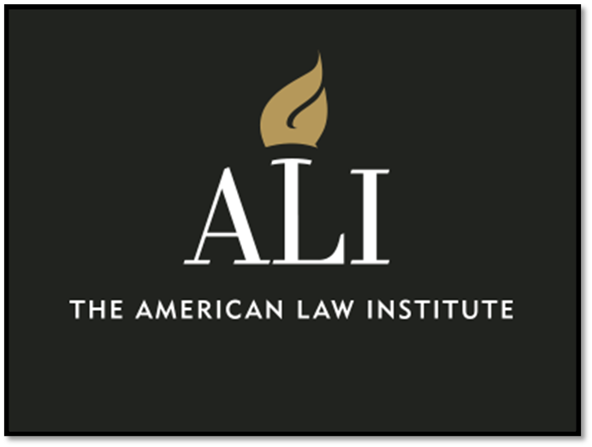
Who is the ALI?
The American Law Institute is an independent body made up of influential lawyers from across the United States. The ALI analyzes legal issues and proposes model legislation (known as “codes” or “restatements”) and recommends that states adopt that model legislation as their own law. This requires that each state legislature pass a bill that changes the state law, but many states have in the past adopted ALI model codes without significant changes.
Notes:
The last time the Model Penal Code on Sexual Assault was revised was in 1962. That shows how badly a revision was needed and why State sexual assault laws are such a confusing patchwork throughout the U.S.

Slide 4
Who is the NCSF?
The National Coalition for Sexual Freedom (NCSF) is a coalition of Alt-sex groups and businesses: over 160 Coalition Partners, primarily in the U.S.
NCSF is an advocacy group that challenges systemic discrimination in government and private sector services
NCSF provides education about the Alt-sex communities for agencies and professionals
NCSF was established in 1997 – 26 years of advocacy
Notes:
First, a bit about NCSF.

Slide 5
Want to learn about the history of this change?
NCSF has run the Consent Counts project since 2007 aimed at decriminalizing kink.
The creation of Explicit Prior Permission is groundbreaking because, people who engage in BDSM and kink, even if it’s consensual, may still be violating their current state law.
NCSF has documented their involvement of this project since 2006:.
Visit the Consent Counts page on NCSFreedom.org
Notes:
Decriminalizing BDSM was deemed the most critical issue our communities faced when Consent Counts was created in 2006 by the Leather Caucus at NGLTF’s Creating Change.
Soon after that, NCSF took responsibility for Consent Counts and began a series of Consent Surveys with a number of peer-reviewed papers, Consent Discussions, the creation of a Consent Statement in conjunction with kink educators, and consent education for the kink and CNM.
The Consent Counts project is similar to what NCSF did to help depathologize BDSM by working with the American Psychiatric Association to change their diagnostic manual in 2013. Prior to that, kinky people were considered to have a mental illness and often child custody was removed simply because a parent was kinky.

Slide 6
“Consent is not a defense to assault.”
Not a single appellate court decision anywhere in this country has accepted consent as a defense in an assault or abuse prosecution arising from BDSM conduct.
Notes:
Explicit Prior Permission was developed to counter the old saying, that you may have heard - “Consent is not a defense to assault.”
That’s because there is not a single Appellate court decision anywhere in this country that has accepted consent as a defense in an assault or abuse prosecution arising from BDSM conduct.
An Appellate case is a criminal case that has been appealed, and that sets case law which is different from legislation that’s passed by state legislatures.
These court cases include relatively mild activities like, playing with riding crop or dripping hot wax without burning someone.

Slide 7
NCSF’s database of consent cases involving BDSM
Case Index
Sex Is Not A Sport: Consent And Violence In Criminal Law 2001-2002
Beyond The Pleasure Principle: The Criminalization Of Consensual Sadomasochistic Sex 2001-2002
Morality-Based Legislation Is Alive And Well: Why The Law Permits Consent To Body Modification But Not Sadomasochistic Sex 2006-2007
The Right to Be Hurt: Testing the Boundaries of Consent February 2007
Pain, Pleasure, And Consenting Women: Exploring Feminist Responses To S/M and Its Legal Regulation in Canada Through Jelinek’s The Piano Teacher 2007
Consent to Harm 2007-2008
Autonomy, Dignity, and Consent to Harm 1/29/2008
The Moral Limits Of Consent As A Defense In The Criminal Law 2009
California v Samuels 4/28/1967
Massachusetts v Appleby 4/1/1980
Iowa v Collier 5/25/1985
Helton v Indiana 12/1/1993
New York v Jovanovic 12/21/1999
Lawrence v Texas 6/26/2003
Nebraska v Van 11/12/2004
California v Febrissy 7/1/2006
Govan v Indiana 9/9/2009
Rhode Island v Gasper 10/30/2009
Commonwealth v John Carey 7/23/2007
United States, Appellee v Miles 3/24/2014
Law Review Articles
https://ncsfreedom.org/legal-issues/
Notes:
This is NCSF’s legal database of consent cases involving BDSM and Law Review articles about legal cases involving BDSM and consent.
This kind of criminalization feeds the stigma and discrimination against kinky people, and our gathering places.
Consent Counts originally wanted to assist in an Appellate case in support of consensual BDSM in order to overturn the outdated case law.
However, there were no more prosecutions of consensual BDSM, ironically in part due to the fact that NCSF educated law enforcement agencies around the country about BDSM and the “alleged domestic violence call” mostly became a thing of the past.
Instead there were only cases where consent was denied by the bottom.

Slide 8
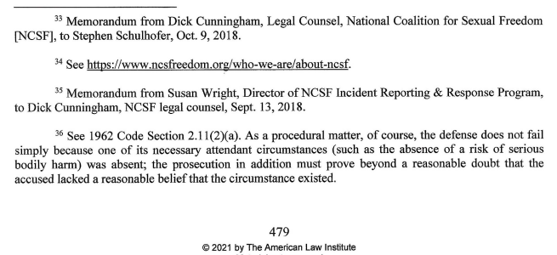
NCSF’s Role
Notes:
So in 2015, Consent Counts launched the American Law Institute project, when the ALI began to revise the Model Penal Code on Sexual Assault. NCSF’s Legal Counsel, Dick Cunningham, joined the ALI to liaison with them about consent for kink.
As you can see from these footnotes, NCSF was cited in the Reporter’s Notes of the revised Model Penal Code on Sexual Assault, Section 213.10.
The ALI relied on NCSF for information about our communities’ consent standards, which contributed to the creation of the legal framework for consent for BDSM activities that is called Explicit Prior Permission. NCSF provided information from: their Consent survey series, from reports made directly to NCSF, feedback received during Consent Discussions and the creation of a Consent Statement, as well as input from its Coalition Partner groups, businesses and private practices.
The MPC on Sexual Assault was approved by the entire ALI membership in 2021 and will be published in 2024. The text for EPP is posted on NCSF’s Consent Counts page along with the commentary and Reporter’s Notes.

Slide 9
Why is Explicit Prior Permission important?
Consent Counts is working with Allied organizations to get Explicit Prior Permission passed in each State.
HOWEVER, the ALI states that EPP can be introduced into criminal court case or cited in briefs to replace outdated case law.
NCSF is already providing Explicit Prior Permission to plaintiffs, defendants, investigators, and prosecutors.
Notes:
Consent Counts is creating Public Policy papers that show how EPP can be adapted to current State law. You can find out how to support this effort in your State on the Consent Counts page.

Slide 10
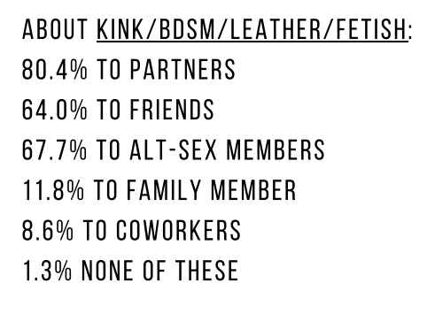
Stigma associated with Criminalization
Percent of respondents who were open
In NCSF’s 2020 Consent Survey, kinky respondents report being closeted to family and co-workers.
Also: Richard Sprott’s Health and Healthcare Experience of Kink-Oriented People.
DOI: 10.13140/RG.2.2.12386.73925
https://ncsfreedom.org/wp-content/uploads/2021/01/Consent-Survey-2020-report.pdf
Notes:
Decriminalizing BDSM will have a huge impact on the daily lives of kinky people, because stigma leads to discrimination. We are also seeing more data that indicates the stigma of being “sick” or “violent” leads to shame and guilt, which may be associated with suicide ideation (Roush, et al 2016).
When you look at NCSF’s Consent Surveys, they’ve found between 80-90% of kinky respondents are closeted to family and co-workers. 20% are closeted to their own partners. (85% of these respondents have accessed kink groups.)
It’s even worse for the millions of people who haven’t accessed educational groups and don’t self-identify as kinky – it’s just how they have sex. They don’t have access to consent and skills education, nor do they have access to our groups and community members who could help destigmatize their desires and teach them how to talk about sex and kink. Debby Herbenick’s prevalence survey, Sexual Diversity in America, found that at least 30% of adults engage in spanking, 22% in roleplay and 20% in bondage, but less than 4% reported attending an educational workshop.

Slide 11
Barriers to Reporting
Of the 1,041 people who reported nonconsensual experiences
only 29 people (2.7%) said that they reported it to the police
NCSF’s Consent
Violations Survey
(2015)
If the legal system can better accommodate BDSM-related cases through Explicit Prior Permission, one of the major barriers to reporting will be reduced.
NCSF Consent Research - https://ncsfreedom.org/key-programs-2/consent-counts
Notes:
The stigma and criminalization of BDSM also leads to barriers to reporting crimes committed in a BDSM context.
In the NCSF Consent Violations Survey (2015) out of over 1,000 people who reported nonconsensual experiences, less than 3% said that they reported it to the police.
While, our communities are self-regulating, sometimes something criminal happens and we need to use the justice system. Our Justice system is NOT good with sexual assault survivors, especially those with intersectional identities. But it’s the system we are trying to fix, so we have to work with those who can affect the system, and step by step, we are making progress.
If the legal system can better accommodate BDSM-related cases through Explicit Prior Permission, one of the major barriers to reporting will be reduced.

Slide 12
So, what is Explicit Prior Permission?

Slide 13
Consent for BDSM
Section 213:10 - Affirmative Defense of Explicit Prior Permission
You may personally give another person explicit prior permission to use or threaten to use physical force or restraint, or to inflict or threaten to inflict any harm in connection with an act of sexual penetration, oral sex, or sexual contact, as long as it doesn’t cause serious injury.
Notes:
You may personally give another person “explicit prior permission” to use or threaten to use physical force or restraint, or to inflict or threaten to inflict any harm in connection with an act of sexual penetration, oral sex, or sexual contact.
Whatever is done, it can’t cause serious injury. Even with consent, you’re not allowed to seriously injure someone, which is well-defined in law as the impairment of a limb or organ, a permanent mark, or causing a substantial risk of death.
This means this legal framework can’t be used as a defense for certain kinds of edge play like breath play employing compression of the neck, or bondage/suspension where severe nerve damage is done, or branding where a permanent mark is left.
Technically this only applies to BDSM interactions that include touching the buttocks or breasts (clothed or unclothed), or include oral, vaginal or anal sex. In NCSF’s last Consent Survey 2021, 90% of the 3,000 respondents reported they liked to do some kind of sexual touch or penetration with kink activities. Also, things like spanking constitutes sexual touch because it’s touching the buttocks, even when clothed.
NCSF’s public policy papers are showing how State law could adapt Explicit Prior Permission for both Sexual Assault and Assault law, which would then cover BDSM acts that don’t include sexual contact.

Slide 14
Explicit Prior Permission
Permission is “explicit” under Section 10 when it is personally
given verbally or by written agreement:
(a) specifying that the actor may ignore the other party’s expressions of unwillingness or other absence of consent;
(b) identifying the specific forms and extent of force, restraint, or threats that are permitted; and
(c) stipulating the specific words or gestures that will withdraw the permission.
Notes:
The way you get permission that is “explicit” is either verbally or by written agreement:
Explicit prior permission doesn’t mean using body language or past behavior to determine consent.
You must talk about it first to come to an agreement, and even then there are caveats that must be met.
You have to:
(a) specify when someone can ignore your expressions of unwillingness or other absence of consent. This includes saying things like, “No, stop!” or physically resisting. This applies to: Role-playing, Rape play, Consensual non-consent, even Master/slave interactions
(b) name the specific forms and extent of force, restraint, or threats that are permitted. This means everyone has to understand the risks involved, so you can decide what level you want, like: marks/no marks, this thuddy toy/but not that stingy toy, hands no paddles, paddles but no canes
(c) stipulate the specific words or gestures that will withdraw the permission. This includes during consensual non-consent – under this legal framework, you must have a way to stop the use of erotic force or restraint at any time. This can be done through a safeword or safesignal, or if you want to communicate without a safeword, that’s okay too, as long as everyone is aware that any protest or physical resistance signals the end.

Slide 15
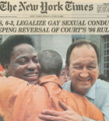
Lawrence v Texas
Lawrence v Texas (which overturned sodomy laws) holds that adults have a constitutionally protected privacy and autonomy rights to engage in mutually consensual sexual activities.
Explicit Prior Permission is based on case law made in Lawrence v Texas, which states that respect for individual autonomy requires deference to these choices.
Notes:
Since consent has not been recognized as a permissible defense, BDSM practitioners have tried to defend against sexual assault claims using a Lawrence v. Texas framework. Explicit Prior Permission is grounded in Lawrence v Texas (which overturned sodomy laws) which holds that adults have a constitutionally protected privacy and autonomy rights to engage in mutually consensual sexual activities. As long as the person giving Explicit Prior Permission does it personally and is a competent adult, and as long as the force used poses no risk of serious injury or harm to others, respect for individual autonomy requires deference to these choices.

Slide 16
General Definitions of Consent for Sex
(i) “Consent” means a person’s willingness to engage in a specific act of sexual penetration, oral sex, or sexual contact.
(ii) Consent may be express or it may be inferred from behavior—both action and inaction—in the context of all the circumstances.
(iii) Neither verbal nor physical resistance is required to establish that consent is lacking, but their absence may be considered, in the context of all the circumstances, in determining the issue of consent.
(iv) Consent is ineffective when given by a person incompetent to consent or under circumstances precluding the free exercise of consent.
(v) Consent may be revoked or withdrawn any time before or during the act of sexual penetration, oral sex, or sexual contact.
2016 - https://thealiadviser.org/sexual-assault/evolution-of-model-penal-code-consent-definition/
Notes:
Now, I want to mention that along with the definition of consent to BDSM, there is also a definition of consent for sexual contact without any use of force or restraint, approved in 2016 in the revised MPC on Sexual Assault.
This definition of consent is critical, because in 20 states, there is no definition of consent in the sexual assault law. However, for the majority of states, this definition does reflect the legal standard of consent that is currently used.
This definition for consent to sexual contact (without the use or force or restraint) is not considered to be “affirmative consent” because of this:
· (ii) Consent may be express or it may be inferred from behavior—both action and inaction—in the context of all the circumstances.
· (iii) Neither verbal nor physical resistance is required to establish that consent is lacking, but their absence may be considered, in the context of all the circumstances.
This is talking about body language being acceptable, and context is things like whether you’ve had sex with someone before or if this is your first time together. Some states, like Illinois, have a more affirmative consent definition in their Sexual Assault law.

Slide 17
Explicit Prior Permission for Consent to Kink
1. Consent must be explicit, that means talking and agreeing to what you’ll be doing before you start.
2. You must specify what kinds of expressions of unwillingness are okay to ignore.
3. You must identify the specific activities and how intense they will be, which requires being informed about the risks.
4. You must agree to a safe-word or gesture that will withdraw permission.
Notes:
Compare that general definition of consent without the consensual use of erotic force or restraint under Explicit Prior Permission:
You need explicit prior permission to do specific BDSM activities before you start; that consent needs to be risk aware and informed, not just “I’m game for anything”; and you need a safeword.
This conforms to many of the current consent standards found in the kink communities. For example, M/s relationships often have a contract, which is explicit prior permission for a wide range of activities. While on the other hand, Leathermen do use a more implied before denied consent model in their spaces that includes sexual touching – so NCSF encourages them to post signs about their consent culture so people can consent prior to entering that space.

Slide 18
How You Can Help
Get Involved
Advocate. Educate. Activism. Act.

Slide 19
WHAT YOU CAN DO
Inform your friends
Post Consent Infographics on social media
Get free literature from the NCSF
Speak out at groups and events about Explicit Prior Permission
Join NCSF as a member and ask your group to join!
Email to get more information and training: NCSFreedom@ncsfreedom.org
Notes:
We need you to help spread the word! We want you to:
Inform your friends
Post NCSF’s Consent Infographics on social media
Speak out at groups and events about Explicit Prior Permission
Join NCSF as a member and ask your group to join!

Slide 20
How The NCSF Can help you:
Tell people to contact NCSF if:
You’re having a criminal issue so we can consult with your attorney or the prosecutor/investigator
Your group doesn’t have a consent policy or procedures to deal with consent violations
Your group would like to provide education to your members about consent, BDSM & the law
Your professional organization would like Cultural Competency training.
Email to refer people to NCSF: NCSFreedom@ncsfreedom.org
Notes:
Tell people to contact NCSF if:
You’re having a criminal issue so we can consult with your attorney or the prosecutor/investigator
Your group doesn’t have a consent policy or procedures to deal with consent violations
Your group would like to provide education to your members about consent, BDSM & the law
Email to refer people to NCSF: NCSFreedom@ncsfreedom.org

Slide 21
Activism
You can prepare for lobbying by researching your own state legislators to find out:
How much do they advocate for marginalized groups, like the LGBTQ communities, homeless shelters, harm reduction, domestic violence organizations, or social justice movement?
Do any of them have a law enforcement background?
Have any of them supported sexual assault prevention legislation?
You can read NCSF’s existing public policy papers on Consent Counts
Notes:
You can prepare for lobbying by researching your own state legislators to find out:
How much do they advocate for marginalized groups, like the LGBTQ communities, homeless shelters, harm reduction, domestic violence organizations, or social justice movement?
Do any of them have a law enforcement background?
Have any of them supported sexual assault prevention legislation?
This will lay the ground to lobbying state legislators to adopt Explicit Prior Permission as your state law. We will be beginning that effort with Maryland and Washington State, and possibly NY.

Slide 22
Local Works
You can do outreach to your local rape crisis center or anti-violence project, and suggest that NCSF give them an Interpersonal Violence & BDSM Cultural Competency webinar.
Here is a Sample email that you can send - https://docs.google.com/document/d/1JjWypH7uDD-9uOXiQYrYW4EjWfgQdAax7w7fUUd7dnw/edit?usp=sharing
Volunteer for your local crisis center! They need your help and your voice for kink and CNM survivors.
Notes:
Consent Counts is now educating the kink communities about Explicit Prior Permission. The next step is to educate our allies, such as victim advocacy agencies, state Coalitions Against Sexual Assault, and LGBTQIA and sex worker advocacy organizations. You can help with that!
We will also educate the legal community – defense attorneys, prosecutors and investigators – that explicit prior permission is the basis for consensual kink, and equip prosecution for when someone doesn’t get explicit prior permission or when serious injury is done.
You can do outreach to your local rape crisis center or anti-violence project, and suggest that NCSF give an IPV & BDSM Cultural Competency webinar.
Here’s a Sample email that you can send - https://docs.google.com/document/d/1JjWypH7uDD-9uOXiQYrYW4EjWfgQdAax7w7fUUd7dnw/edit?usp=sharing
Volunteer for your local crisis center! They need your help and your voice for kink and CNM survivors.

Slide 23
Learn More
NCSF Consent Count Resources
American Law Institute
Video: Model Penal Code: Sexual Assault and Related Offenses - Overview of Tentative Draft No. 5 (2021)
The ALI Advisor
Notes:
Based on the new legal framework of Explicit Prior Permission, NCSF has updated and created new resources, brochures, cards and graphics for groups that you can share with others:
Best Practices for Consent to Kink – For example: All activities must receive prior consent explicitly by verbal or written agreement rather than through gestures, body language or past behavior. And Informed consent requires a discussion of the risks involved in the activity and the steps that are needed to reduce those risks including: study, training, technique and practice.
Best Practices for Consensual Non-monogamy – For example: Do you feel you have an equal say in deciding your relationship agreements with each of your partners? Do you feel you have enough information to understand and to agree to any potential risks involved, and inform each other about any change(s)?
Guide for Groups - Consent P&P - This document outlines options and sets expectations for your group members who report consent issues inside and outside of your events, with procedures on how consent reports will be dealt with so everyone is on the same page. This Consent P&P can be adjusted for your group’s consent culture and structure.
Guide for Groups - Outing Guide - This document can also be adjusted by your group to deal with outing and define it for members and set expectations around what is allowed with sharing information about someone.

Slide 24
To Get Explicit Prior Permission for Consent to Kink
Did you discuss the risks and agree how intense it will be? Note: You can’t seriously injure someone, even if they consented
to the act.
Did you agree to the specific acts you’re going to do together, including if there’s going to be any sexual contact like touching the breasts or genitals?
Is everyone an adult and able to consent -they’re not under the influence, in subspace, having a mental health crisis or a significant reduction in capacity.
Do you have a way to stop at any time - even if you’re doing consensual non-consent - like a safeword or safe signal?
What verbal or physical resistance did you agree that it’s okay to ignore, i.e.. in roleplay or power exchange.

