Slide 1

NCSF
Consent Counts COMMITTEE Tabling Training
Notes:
INTRODUCTIONS

Slide 2


Before we begin:
NCSF’s reputation must be spotless to do the work we do.
Consent Counts volunteers must also have a reputation above reproach.
We do vet our volunteers though IRR, and some of the things that would disqualify you are:
  Consent Violations
  Predatory Behavior
  Outing and Doxing
  Group or event bans
  Discriminatory or harassing behavior in person or online
Now would be the time to disclose any issues you may have had.
Reports coming to us after your appointment will also exclude you.

Slide 3

What Does a Consent Counts Volunteer Do?
Consent Counts volunteers will be able to educate their local communities about consent for kink and non-monogamy, and discuss the resources Consent Counts offers.
Consent Counts volunteers are not speaking for the NCSF, they are speaking about the Consent Counts program.
Notes:
This also takes the pressure off of tablers.

Slide 4


Goals for Consent Counts Volunteers
Educate your local and regional communities about Consent Counts
Inform about consent for kink through Explicit Prior Permission and our lobbying project
Educate about consent for non-monogamy
Inform individuals and community organizers about NCSF’s consent resources:
    Consent Counts
    Incident Reporting & Response
    Kink and Polyamory Aware Professionals
    NCSF’s Education Outreach Project consent workshops
Consent Counts Tabling

Slide 5
EXPECTATIONS OF A Consent Counts TABLER
Please be polite and courteous to event staff and attendees.
Please dress appropriately for the event.
  It is important that we remember we are a professional organization. We need to be neat in appearance and portray a professional image when tabling.
Please do not speak ill of any of the NCSF constituencies, NCSF programs, staff or volunteers.
Please be at the table or have someone at the table at all designated times.
Please fill out the event report soon after returning from the event
  https://ncsfreedom.org/event-donation-report/

Slide 6
Expectations, continued
It is important that Consent Counts volunteers stay on message about Explicit Prior Permission. It is never OK to undermine this legal framework.
  MOST of our resources are guidelines that are intended to be adapted for specific situations, however some things are hard-and-fast like EPP. NCSF is telling people what EPP means and how to apply it, so we all need to be on the same page about that.
If someone disagrees with Explicit Prior Permission, please bring it to Susan Wright or Tess Zachary so we can help respond.
  Particularly with the pending effort around Explicit Prior Permission it is more important than ever to behave professionally and appropriately. Your behavior in person and online reflects on Consent Counts. If these expectations are not met, you may not be allowed another opportunity.

Slide 7


Stay Up to Date
We need our Consent Counts volunteers to stay involved and up-to-date.
In this important legislative year, messaging matters, and while we do our best to push information, we are all volunteers, so we must work together.

Slide 8
Consent Counts
Table of Contents
Want to Help?
Best Practices
Public Policy Papers
American Law Institute (ALI) Project
Consent Month – Celebrate in September
Consent Signs – Download our consent signs!
Consent in Context – Watch the video
Consent Counts Statement
Consent Counts Legal Databases
Guides for Groups, Events and Clubs
Assistance for Individuals
Surveys on Consent
Discuss Consent
Consent Counts aims to decriminalize sexual conduct between consenting adults.
Our objective is to decriminalize sexual conduct between consenting adults. As part of this we spread understanding of the need for, and nature of, consent. Our Consent Counts program is designed to assist our communities in promoting a culture of consent through education and providing resources on how to deal with nonconsensual incidents.
A chief goal is to decriminalize consensual BDSM (Bondage, Discipline, Dominance/Submission, Sadomasochism) that does not result in serious physical injury by ensuring that consent will be recognized as a valid defense to criminal charges brought under assault laws and other statutes.
https://ncsfreedom.org/key-programs-2/consent-counts/

Slide 9

Explicit Prior Permission
The most important initiative in 2025 and 2026
Notes:
Something everyone should know regardless of your constituency about is Explicit Prior Permission. While this may only seem relevant to the kink Community, please remember that Debbie Herbenick’s prevalence survey found that 30% of adults engage in some sort of BDSM or Kink, and we know from our own experience that many constituent groups participate in these activities, even if that is now how they identify.
This messaging is so important in 2024 and 2025 as the new Model Penal Code is published (likely in the Fall of 2024) and we quickly pivot to our lobbying initiative.
Be very familiar with history and practical application of EPP in our Communities, and we are going to share some resources to help you.

Slide 10
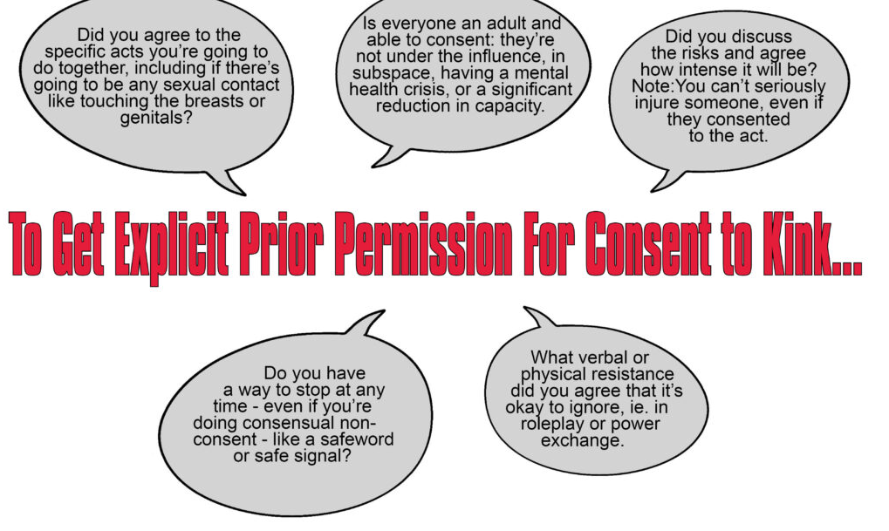

The Quick Reference
Notes:
The first thing to know about is the 5-quick steps.
On the consent counts page at the VERY top is a quick reference about the steps to getting Explicit Prior Permission
This is a graphic of the back side of the EPP Post card you can order or view from the Materials Order Form

Slide 11
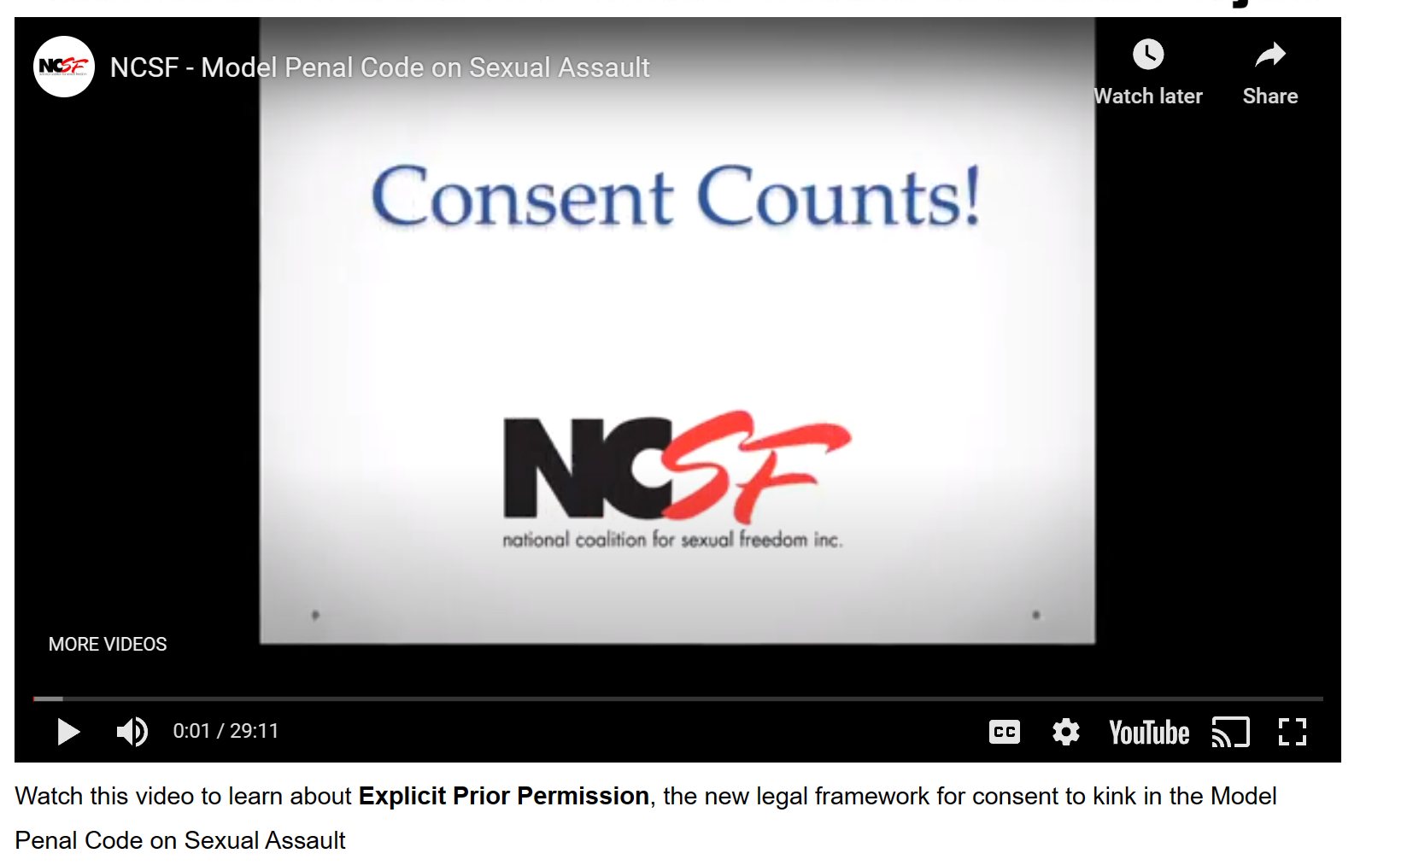
Video https://ncsfreedom.org/key-programs-2/consent-counts/
Context
History
Details and nuance beyond the high-level five (5) steps
Notes:
The next thing you should probably watch and familiarize yourself with is ALSO on the consent counts page right underneath the quick reference is a 30-minute video which explains EPP, provides a video by the associate reporter Erin Murphy of NYU law, explains NCSF’s part in making this happens, and provides the nuances you may have missed to help contextualize this change.

Slide 12
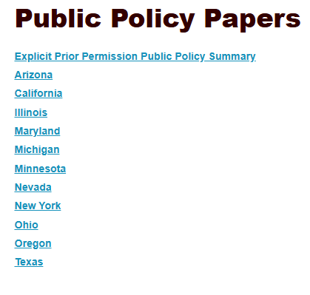
Lobbying for Explicit prior Permission
Resources to help spread the word about EPP:
  11 Public Policy papers you can use to do outreach in your state
  An EPP summary you can use in any state to assist in outreach to allies.
  Talking Points about EPP
  How to publicize EPP
  Background on the American Law Institute project

Slide 13

Legal Issues https://ncsfreedom.org/legal-issues/
NCSF Briefs – We filed a brief with our allies against FOSTA because of the de-platforming of sex educators and therapists as well as sex workers
Consent Legal Cases – We have gathered the case law and law review articles on consent in a kink context - https://ncsfreedom.org/consent-legal-cases-3/
Legal Resources Page-includes Erotic Choking Paper, Interrogatories, Kink and the UCMJ, and Non-monogamy and the UCMJ

Slide 14
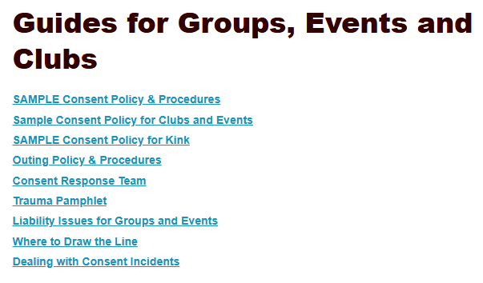
Assistance for Our Communities

Slide 15
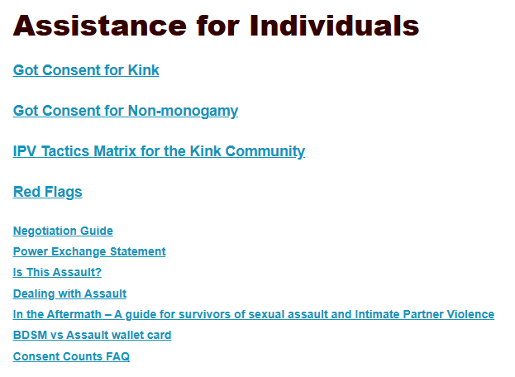
Assistance for Our Communities

Slide 16
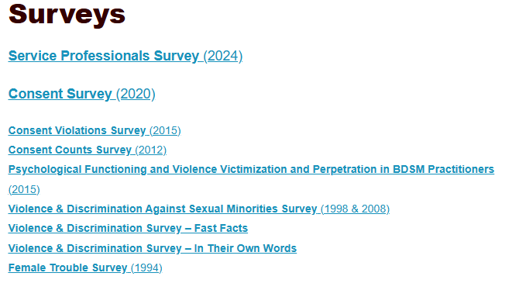
History of NCSF
Research on Consent
The 2025 Consent Survey has launched. NCSF’s research helps us create resources that provides individuals, groups, clubs, events, and professionals with educational information. Please participate and add your voice to the solutions for our communities.
NCSF has had 22 papers published in peer-reviewed journals since 2006.
Notes:
We have a table tent with a QR Code for this survey.

Slide 17
Traps while tabling
Some people may be upset because certain kinks aren’t covered by EPP. Remind them that almost no impact play or restraint is legal now under case law. We’re moving the bar far over to the side of things that could be considered serious injury.
Permanent serious disfigurement doesn’t mean you have a keloid or a small scar. It’s for big things like branding gone infectious, which causes serious health risks and a lot of time and money to treat. Typically, the person affected would have to complain that it’s a disfigurement.
Consent Counts is working with the justice system because that is the system we’re trying to change. It’s the same thing we did with the APA when we worked with them to make them change their criteria to say that being kinky didn’t mean you were mentally ill. NCSF’s job is to work to make institutional and systemic change. If we can get the justice system to acknowledge affirmative consent for kink, then that is real solid change that can be credited to the kink communities.

Slide 18
Kink Aware Professionals
A free database of professionals who offer “Sex-Positive Support for Kink and Non-monogamy.” This includes mental health, legal, medical and other professionals who are knowledgeable about consent such as:
  Mediators to help individuals resolve interpersonal disputes
  Trauma-informed counselors to refer to those reporting a consent violation
  Civil attorneys to assist survivors in getting assistance with medical bills, pain & suffering and lost work
  Criminal Defense Attorneys to assist those who have been accused of consent violations
https://www.kapprofessionals.org/

Slide 19

History of NCSF
Incident Reporting & Response
IRR directly helps hundreds of individuals, groups and businesses every year who need assistance with taking reports of a consent violation or sexual assault, creating a consent policy, and setting up procedures on how to take reports.
Right-hand sidebar - Incident Reporting & Response Annual and Quarterly Reports –
https://ncsfreedom.org/incident-reporting-response/

Slide 20
For Groups
NCSF group members who want to participate in the IRR process, must sign a Confidentiality Agreement. While everyone should understand that, NCSF puts ourselves at risk when helping our member groups, so a clear understanding is important.
Occasionally NCSF will take reports for our member groups if they are developing procedures to take reports of consent violations, or if someone would like to first report to a neutral third party who can also provide resources and referrals to trauma-informed counselors.
Often, helping people with their consent policies, response teams and reporting practices goes hand-in-hand with reports from people NCSF may receive.

Slide 21
Additional IRR Information
NCSF will share “Best Practices,” resources and recommendations for groups to create their own systems.
Confidentiality is
our greatest value
Notes:
While NCSF will share “Best Practices” and other resources and recommendations for groups to create their own systems, as a national organization we cannot possibly understand the culture of each organization or local community, so we cannot adjudicate, investigate, or meditate on any particular issue, report, or person specifically.
as a national organization we cannot possibly understand the culture of each organization or local community, so we cannot adjudicate, investigate, or meditate on any particular issue, report, or person specifically.
Incident Reporting and response is heavily siloed so that in no circumstances will the same person talk to more than one side on an issue to avoid the kind of unconscious bias that could be present. We believe everyone deserves our help if they seek us out, and we want everyone to be able to come to us without fear of internal bias or threat to their confidentiality.

Slide 22
When people come to you…
  Be empathetic, but refer them to IRR for help
  If appropriate see if the event has a reporting process/CRT you can refer them to
  These things are always complex and messy, please don’t comment, give mental health diagnosis or advice (even if you are qualified to do so!), and refer them to IRR.
  These things heat up and go public often. Please speak as though anything you say will end up on social media being credited to NCSF for having said it, because it probably will.

Slide 23
What to Say about IRR?
Don’t
Comment on specific information, reports, or people… even if you personally know.
Black list: NCSF does not maintain a “Blacklist” or “Ban list.” NCSF would never tell groups or events what to do, because we cannot possibly be an expert in every region.
Reporters deserve confidentiality and respect. Someone who has been reported does not “deserve” this information nor will they receive it.

Slide 24
I.R.R. Traps while tabling
While NCSF takes reports through Incident Reporting and Response, it is important that we don’t leave anyone with the impression that you are taking incident reports at the table. Because we talk about consent, often people will want to share very intimate details of consent incidents. It is OK to be empathetic and compassionate, but you want to make sure you share IRR with people so they can report. They can use the form or call. IRR is trained specifically to gather and provide appropriate resources for people, and all IRR activity needs to be documented.

Slide 25
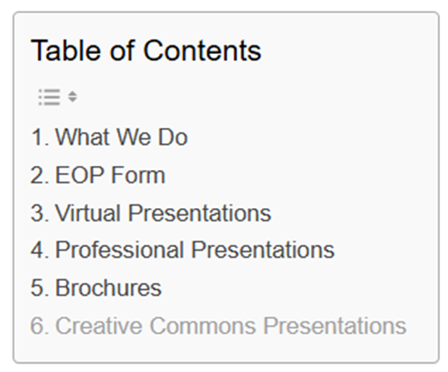
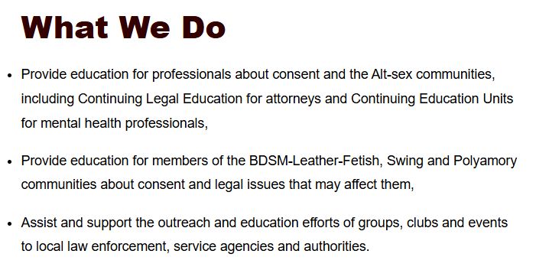
Education outreach Program
Notes:
What EOP does is
Provide education for professionals about consent and the Alt-sex communities, including Continuing Legal Education for attorneys and Continuing Education Units for mental health professionals,
Provide education for members of the BDSM-Leather-Fetish, Swing and Polyamory communities about consent and legal issues that may affect them,
Assist and support the outreach and education efforts of groups, clubs and events to local law enforcement, service agencies and authorities.
Other things on this page are:

Slide 26
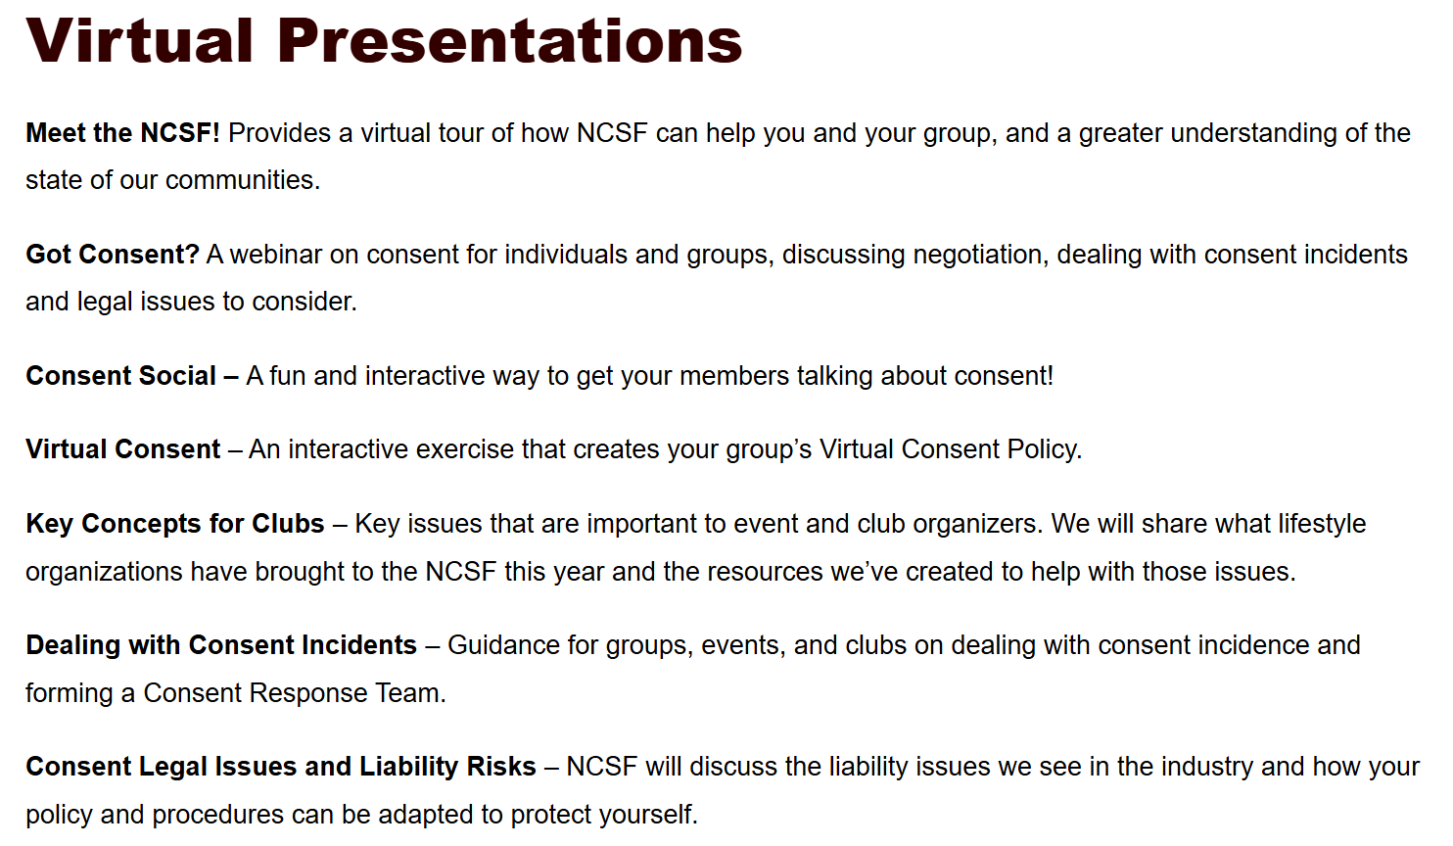
Notes:
Virtual Presentations for our Communities.
These are things we do all of the time (more than 30 in 2023).
Like Meet the NCSF, Got Consent-which is constituency dependent, the Consent Social, which is also tailored to the constituent group, and Virtual Consent which we began In 2020, but has remained valuable.
We also do Professional Presentations

Slide 27
Professional Presentations
Examples
  IPV vs. BDSM
  Providing Culturally Competent Client Services to the Kink Communities for various industries like legal and mental health.
  Providing Culturally Competent Client Services to the Consensual Non-Monogamy Communities for various industries like legal and mental health.
  Consent and Kink on College Campuses

Slide 28
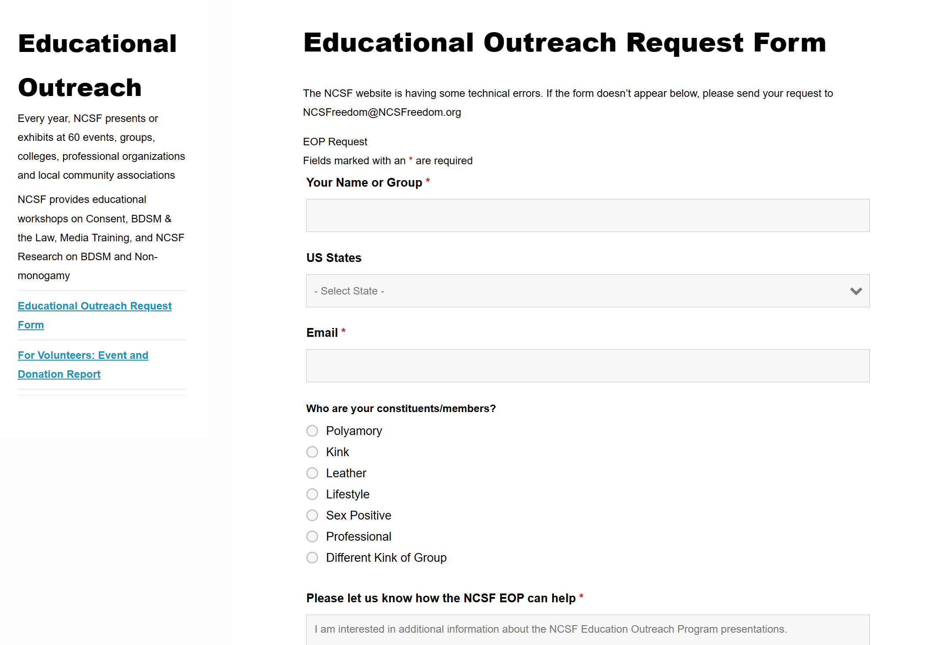
Notes:
We often tailor presentations for what a group needs at that moment. Our list of presentations is just an outline.
Eop is a very busy group, and we are constantly redoing material and creating resources for our constituency.
Speaking of Material…

Slide 29
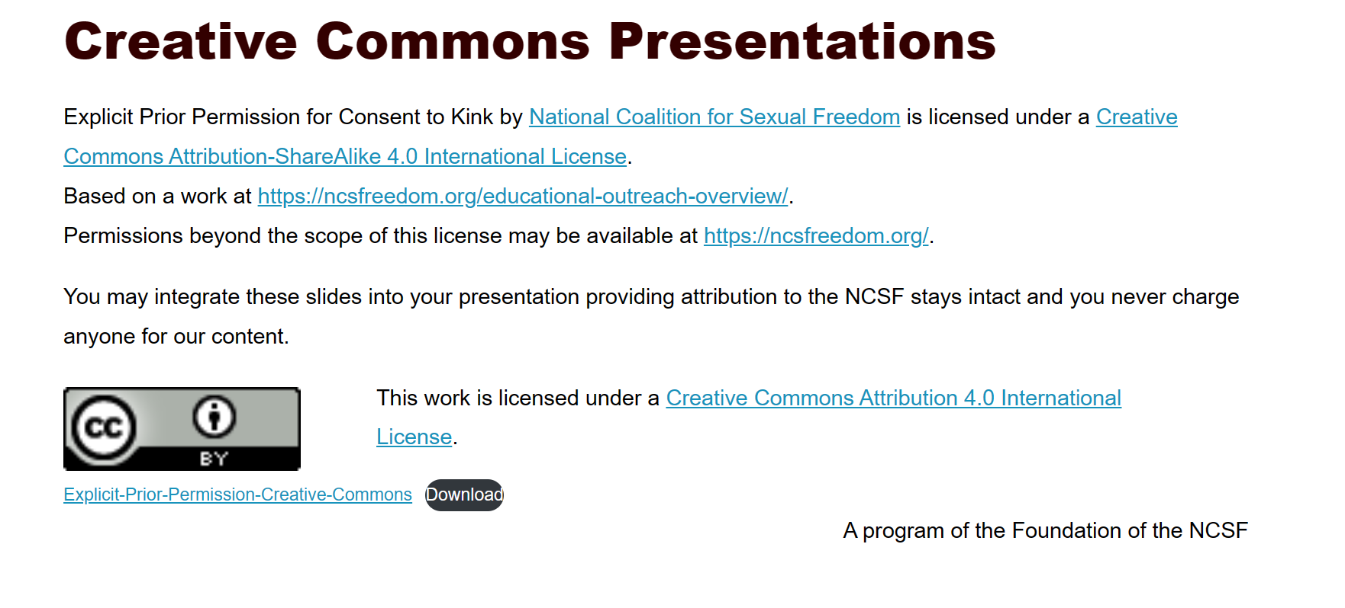
Creative Commons Explicit Prior Permission
https://ncsfreedom.org/educational-outreach-overview/
Explicit Prior Permission for Consent to Kink by National Coalition for Sexual Freedom is licensed under a Creative Commons Attribution-ShareAlike 4.0 International License.
You may integrate these slides into your presentation providing attribution to the NCSF stays intact and you never charge anyone for our content.
Notes:
On the Educational Outreach Page you can find our Creative Commons Presentation on EPP. This can be integrated into all Educational Content as long as you provide attribution to the NCSF and never charge anyone for our content.
Educational Outreach - National Coalition for Sexual Freedom (ncsfreedom.org)

Slide 30

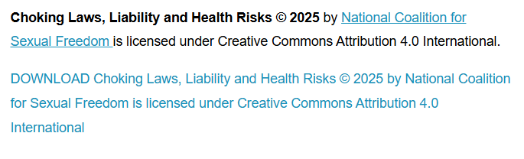
Choking Creative Commons Slides

Slide 31
Material Order Form
Notes:
Something you should know how to do and how to teach other people to do, is to order NCSF Materials

Slide 32
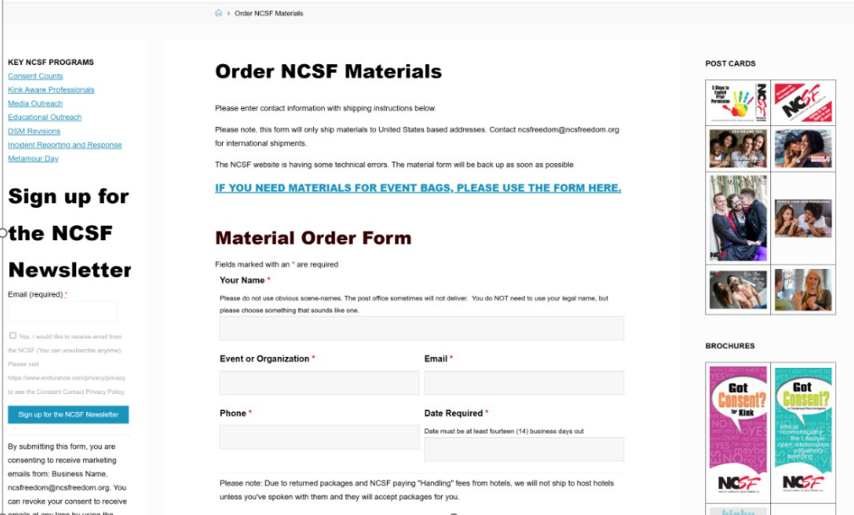
Notes:
The NCSF Materials Order form is available to everyone free of charge.

Slide 33
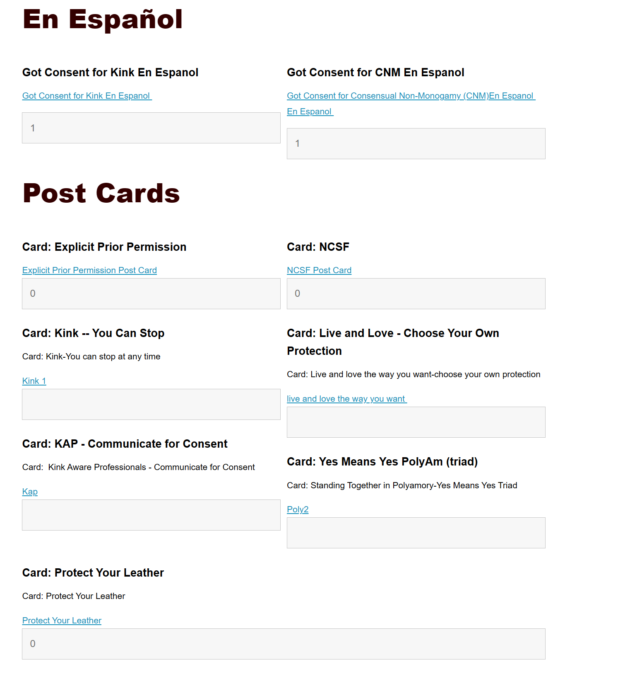
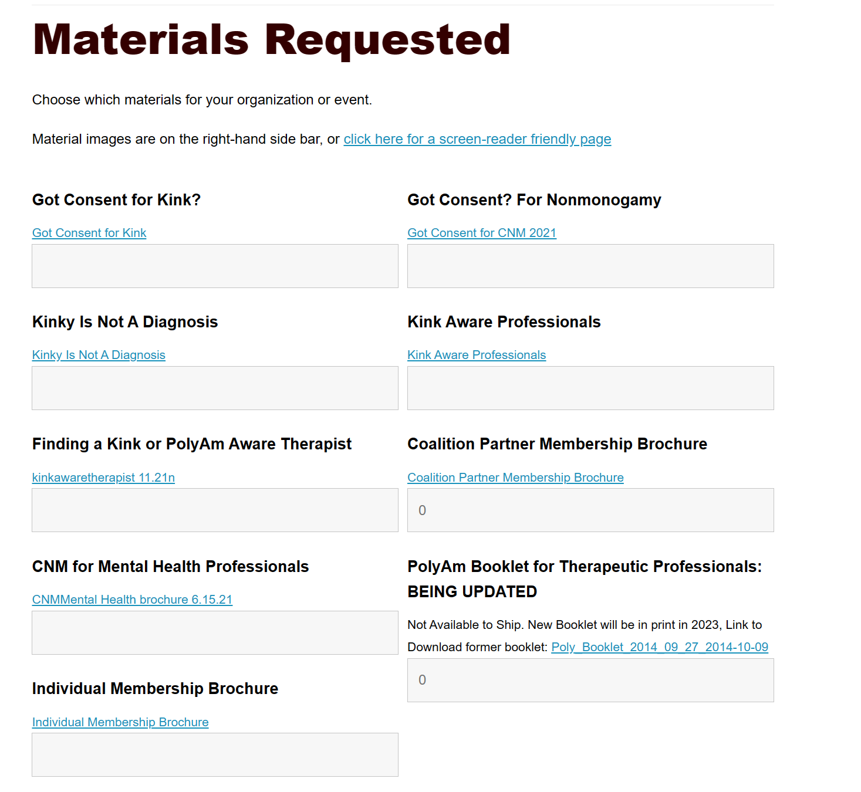
Notes:
It includes all of our brochures and post cards.
Check out our free brochures like our Got Consent? for Kink and Non-monogamy -

Slide 34
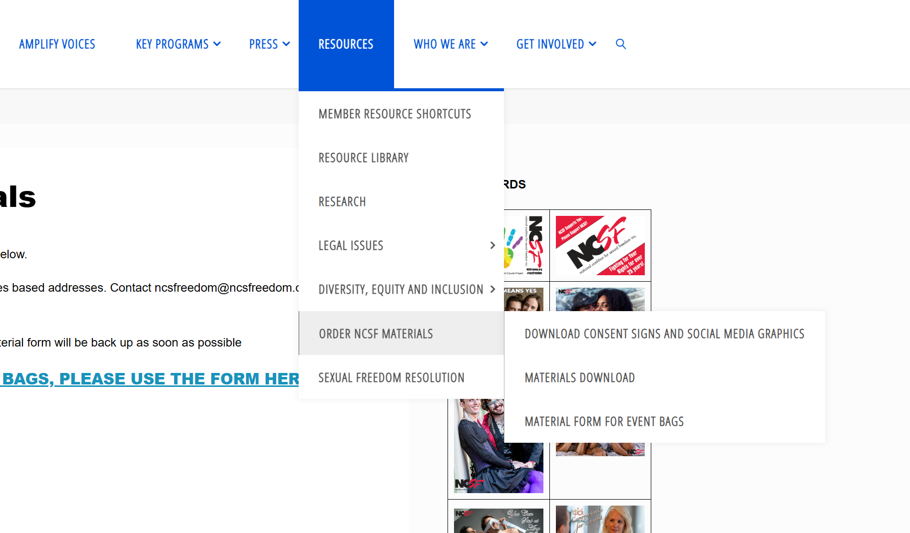
Notes:
Other things on the Order NCSF Materials Menu are our Consent Signs and Social Media Graphics

Slide 35

Notes:
This page has over 50 ever rotating social media graphics and all of our consent signs thanks to the EOP and the PR Committee

Slide 36
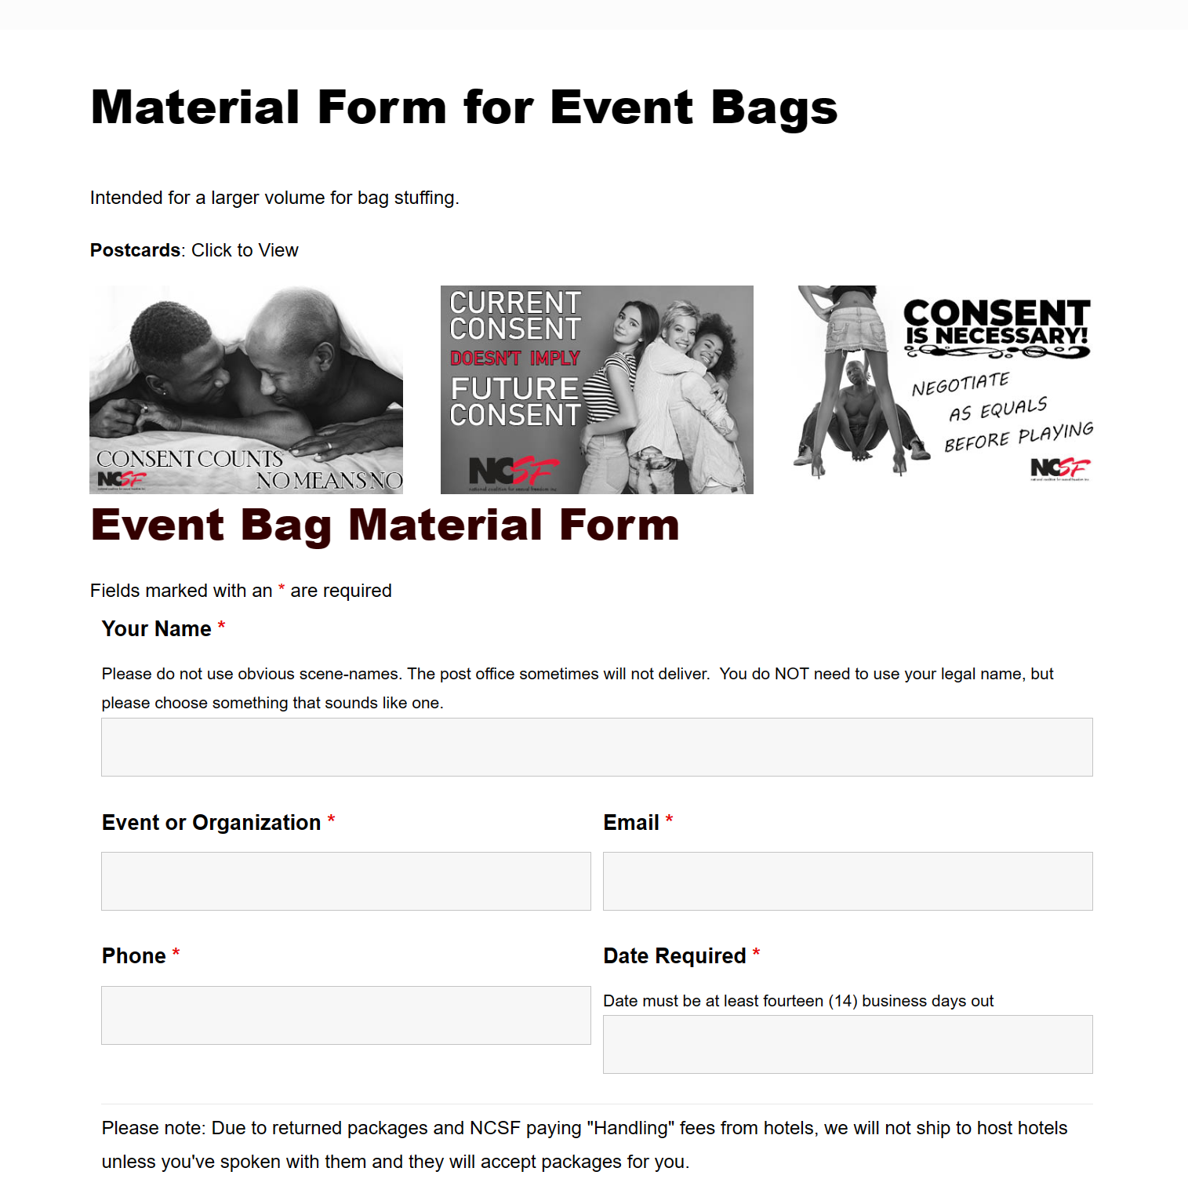
Notes:
The last thing we want to share is our material form for event bags.
This form is linked from the material order form as well as the “order NCSF materials” menu
These are intended as bag stuffers for events.

Slide 37
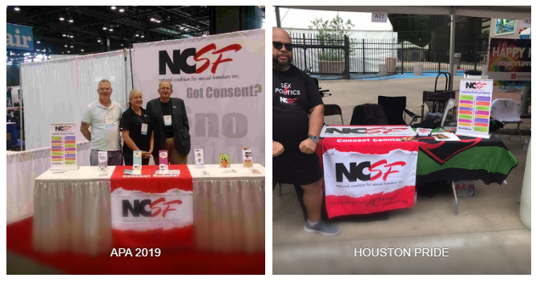
Tabling Page
Visit the Tabling Page for quick links, scripts, and everything you may need at-hand
https://ncsfreedom.org/tabling/

Slide 38
Tabling Page
Quick Scripts
Sample Email: Our Asks
Elevator Pitch
Three Minute Speech
Marketing Language for Fundraising
Samples of former Event Setups
Donate/Join Table Sign
EPP VIDEO
5 steps to get Explicit Prior Permission:
Guides to view or download
Tabling Guide
Liaison Guide
Guide for Groups

Slide 39
Quick Program outline
Consent Counts: Goal to decriminalize sexual conduct between consenting adults.We spread understanding of the need for, and nature of, consent. Our Consent Counts program is designed to assist our communities in promoting a culture of consent through education and providing resources on how to deal with nonconsensual incidents.
Education Outreach Program: Providing education for our community and professionals.
The Freedom and Privacy Project: Designed to fight the Sexually Oriented Business and the Absolute Prohibition of Live Sex Acts Ordinances. These things threaten our constitutional right to gather in private.
Kink Aware Professionals: A free database of professionals who offer “Sex-Positive Support for Kink and Non-monogamy.”
Incident Reporting & Response: IRR directly helps hundreds of individuals, groups and businesses every year who need assistance with taking reports of a consent violation or sexual assault, creating a consent policy, and setting up procedures on how to take reports.
Media Outreach Project: NCSF offers resources for both the media and group/individuals who would like to speak out. NCSF offers Media Training on request which includes Interview Tips for speaking with the media, Crisis Management, and sample Sound Bites for BDSM, Polyamory and the Lifestyle.

Slide 40
Traps while tabling
Sometimes, someone wants to complain about NCSF policy or decisions. Please keep it positive and refer people to the main email address: NCSFreedom@NCSFreedom.org
  Five (5) people get this email, so that it can be routed appropriately.
Please remember, people generally only tell part of a story, or omit relevant facts, so don’t be quick to jump to conclusions about decisions NCSF did or did not make.
  Refer people to us so we can address their concern.
Do not commiserate or agree on incomplete information.
  Useful phrases such as: You should take this to our Executive Committee so they can address your concerns. That sounds distressing, please reach out to the Executive Committee so they can help you. Email: NCSFreedom@NCSFreedom.org

Slide 41


Reimbursement
People like candy!
You can receive reimbursement for expenses that are approved by Susan or Tess prior to the event
Along with the colorful postcards and brochures, buy some candy, including sugar-free candy! Put each kind in a different bowl on the table. It’s about $15-$25, depending on the size of the conference.
Dollar stores are
a great place to
get candy, bowls,
and stands for
material.
Please fill out the event report soon after returning from the event:
  https://ncsfreedom.org/event-donation-report/
Notes:
We don't want to accidentally cause a medical emergency, so it can help to clearly label the candy bowls and monitor them during the event so they don't end up comingling.

Slide 42
Contacts
When you are tabling, either Susan or Tess will be (generally) available. Our contact information is on the tabling page if you get stuck. Please don’t give the public our personal numbers.
The main NCSF number is on all our materials. You can give this to members of the public.
If you have a problematic person at the table, you can’t satisfy-call one of us and put us on the phone (This rarely happens).
You will receive an email prior to the event with the specific contact information for your tabling hours.
Notes:
*exception-if phones are not allowed to be in use at the event, please make an alternative arrangement. Most event hosts will work with you in this kind of situation. (This could be placed in presenter notes)

Slide 43
If you want an NCSF Shirt…
Links are here: https://ncsfreedom.org/shop/

Slide 44
Just a reminder…
We’ve only shown you a small portion of what Consent Counts and the NCSF has to offer to our communities
Spend some time on our website and you will very likely be surprised by the resources and information we have to offer
You don’t need to know everything, you just need to know it exists, so you can point people in the right direction.
Remember, we are always just an email away at NCSFreedom@NCSFreedom.org

Slide 45

If People want to Get Involved – https://ncsfreedom.org/get-involved-2/
There are lots of ways for people to get involved in NCSF
Join
Give
Volunteer
Spread the Word
Wear with Pride
Join KAP

Slide 46
Thank you for your time and attention

